Slide 1
Surveillance and Security Robot
Group No: 39
Project Advisor: Dr. Khalid Mehmood ul Hasan
Department of Electrical Engineering,
University of Engineering and Technology, Lahore
Undergraduate Final Year Project Presentation

Slide 2
Team Introduction
Abdul Rehman Laraib(Team Leader)
2013-EE-032
Specialization: Power
Muhammad Wajahat Hussain
2013-EE-031
Specialization: Power
Muhammad Aquib Aslam
2013-EE-033
Specialization: Power
Rabi-ul-Islam
2013-EE-038
Specialization: Power
Undergraduate Final Year Project Presentation
Dated: 7th November, 2016

Slide 3
Problem Statement
Inaccessible areas in industry or Power Plants:
In industries or plants there are areas where human access is not possible to monitor things due to temperature or radiation effects.
Threat of Theft/Security:
There is a need of monitoring in indoor areas due to security risk and to keep on eye on any doubtful activity.
Undergraduate Final Year Project Presentation
Dated: 7th November, 2016

Slide 4
Proposed Solution
Monitoring of area by live streaming
Motion Detection in Security Mode
Giving Alert on GSM
Overcoming hurdles by Stair Climbing Mechanism
Undergraduate Final Year Project Presentation
Dated: 7th November, 2016

Slide 5
Why a Robot?
Robot can be used for temporary surveillance of any place.
Mobility of robot has an advantage over still cameras.
We can make “smart robot” by introducing autonomy in it.
Undergraduate Final Year Project Presentation
Dated: 7th November, 2016

Slide 6
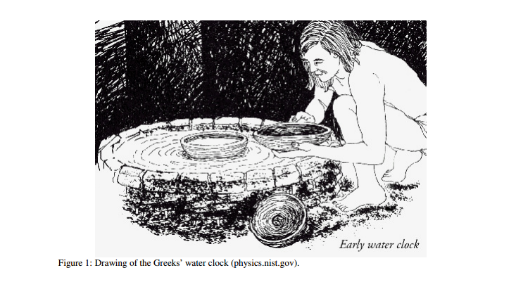
Why a Robot?
It is the desire of human from very beginning to have some tool which can operate automatically.
Undergraduate Final Year Project Presentation
Dated: 7th November, 2016

Slide 7
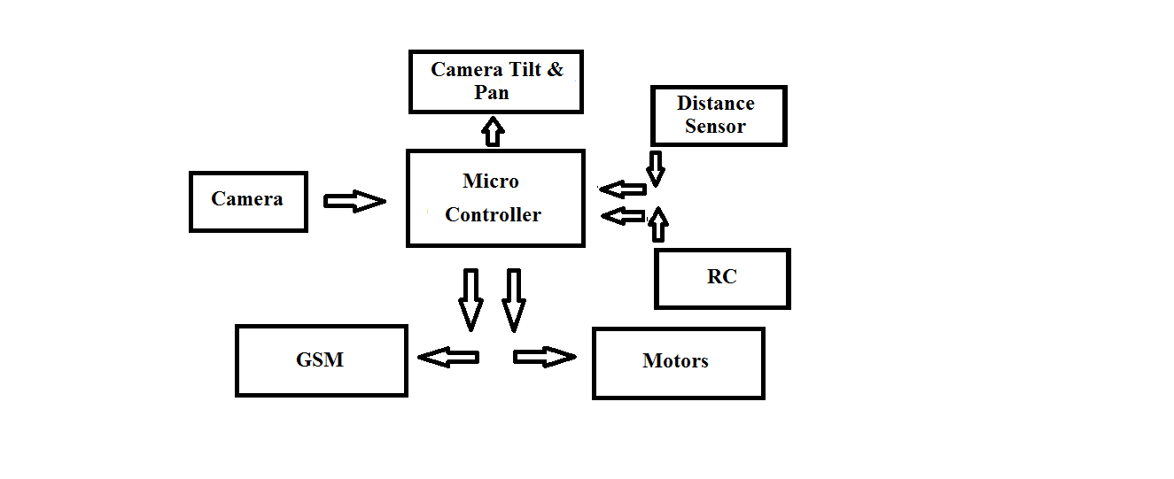
Block Diagram
Undergraduate Final Year Project Presentation
Dated: 7th November, 2016

Slide 8
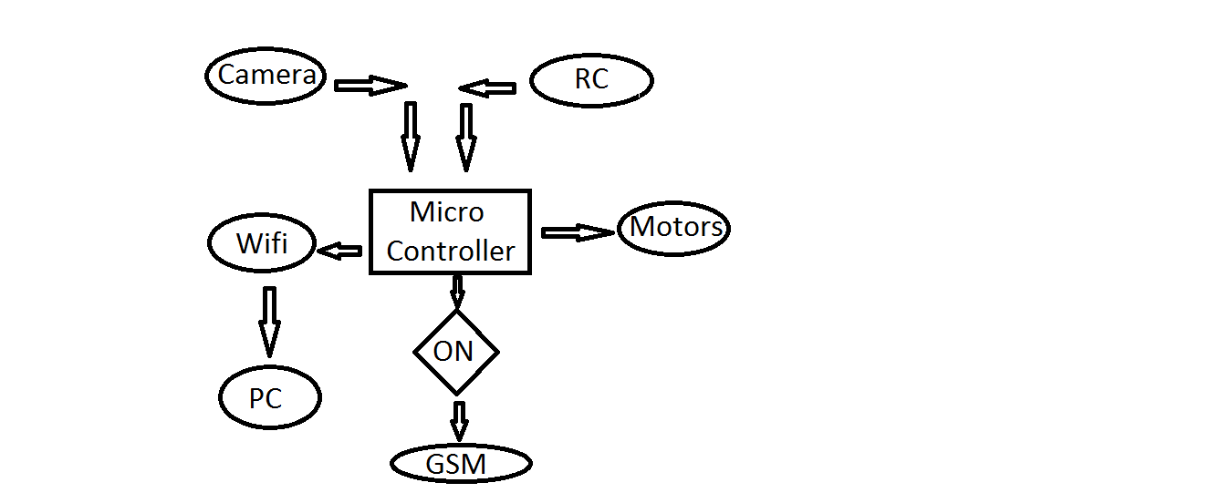
Flow Diagram
Undergraduate Final Year Project Presentation
Dated: 7th November, 2016

Slide 9
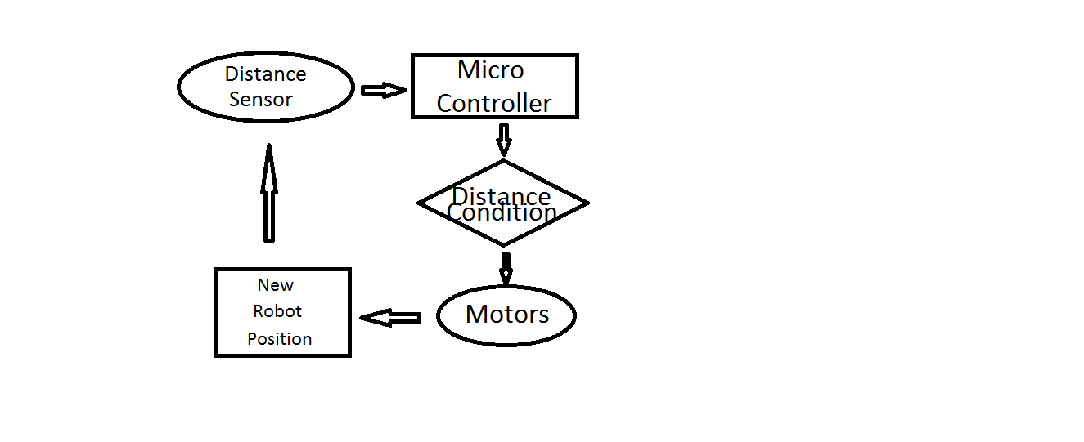
Flow Diagram for Stair Climbing
Undergraduate Final Year Project Presentation
Dated: 7th November, 2016

Slide 10
Applications
Inside area of shopping centers
Temporary security and surveillance
Nighttime monitoring of restricted areas of hospitals, airports & Departments.
Construction sites
Industrial complexes
Power Plant monitoring
Stair climbing vehicle prototype
Undergraduate Final Year Project Presentation
Dated: 7th November, 2016

Slide 11
Audience
Industry
Security Firms
Shopping malls
Undergraduate Final Year Project Presentation
Dated: 7th November, 2016

Slide 12
What have been done so far?
Mechanical Structure:
We have designed and built the structure such that it can climb stairs.
RC Control:
We have configured RC with stm32f4 to control the robot. We are using 4 channel RC controller.
Camera:
We have configured the camera with raspberry pi 3. Web server for live video streaming is yet to built.
Undergraduate Final Year Project Presentation
Dated: 7th November, 2016

Slide 13
What have been done so far?
Mechanical Structure:
The main structure is made up of four (6” X 10”) teflon sheets screwed together using spacers in between them.
Two geared motors(12V around 100rpm) have been mounted on the body to lift the body up and down for stair climbing purpose.
Two linear racks move along the shafts of geared motors to provide lift to the body. These racks are light weight(one is of light weight iron and other one is of teflon) and move in square shaped grooves made in the teflon sheets.
Four tyres and motors drive the robot on ground. We are using differential technique to turn the robot left or right.
Undergraduate Final Year Project Presentation
Dated: 7th November, 2016

Slide 14
What have been done so far?
RC Control:
We are using 4 channel ,35 MHz RC controller to control our robot.
RC is interfaced with Stm32f401 microcontroller. Since RCs are used to control servo motors,as they give a pulse of 50hz with a pulse width of 1-2ms. So in order to control gear motor using this we have done the input capturing of each channel to measure the duty cycle and generate a pwm on another pin accordingly.
Undergraduate Final Year Project Presentation
Dated: 7th November, 2016

Slide 15
What have been done so far?
Camera:
We are using Raspberry pi NoIR (V.2) camera . NoIR camera is used for night vision as it lacks IR filter which block IR radiation in normal camera.
We have configured the setup for OpenCV.
Undergraduate Final Year Project Presentation
Dated: 7th November, 2016

Slide 16
Future Deliverables
Motion detection by camera and OpenCV (In progress).
Object targeting algorithm will be used to target human by laser targeting(depicting laser gunshot).
Camera and laser tilt and pan feature.
GSM based alert(In progress).
Closed loop stair climbing.
Undergraduate Final Year Project Presentation
Dated: 7th November, 2016

Slide 17
Gantt Chart
Undergraduate Final Year Project Presentation
Dated: 7th November, 2016

Slide 18
References
[1] The Social Implication of household Robotics, https://web.wpi.edu/Pubs/E-project/Available/E-project-042008201836/unrestricted/The_Social_Implications_of_Household_Robotics.pdf
[2] Remote control rc support ,
http://www.superdroidrobots.com/shop/custom.aspx/remote-control-rc-support/40/
[3] Lego robots,
https://seriousrobotics.wordpress.com/lego-robots/stair-climbing/
Undergraduate Final Year Project Presentation
Dated: 7th November, 2016

Slide 19
Thank You
Undergraduate Final Year Project Presentation
Dated: 7th November, 2016

