Slide 2
PLC BASED SMART RESTAURANT
Group No: 15
Project Advisor: Mr. HABIB WAJID
Co-Advisor: Dr. KHALID MAHMOOD-UL-HASSAN
Department of Electrical Engineering,
University of Engineering and Technology, Lahore
Undergraduate Final Year Project Presentation
Dated: 12th November, 2016

Slide 3
Team Introduction
M.HAMZA RIAZ
(Team Leader)
2013-EE-168
Specialization: Power
TALHA ZIA MUHAMMAD ALI
2013-EE-175
Specialization: Power
M.MUNEEB
2013-EE-024
Specialization: Power
ABDUS SALAM MAHMOOD
2013-EE-026
Specialization: Computer
Undergraduate Final Year Project Presentation
Dated: 12th November, 2016

Slide 4
Problem Statement
Our research into restaurant management has led us to understand the many peeves and problems facing restaurant-owners and managers in daily operations. For instance, Pakistan is extremely dependent on labors in the service industry. Ever increasing competition in the industry results in overworked, unhappy employees, slow turnaround times at the dining tables, and a lot of inefficiencies in getting orders to the kitchen and food to the diners.
Undergraduate Final Year Project Presentation
Dated: 12th November, 2016

Slide 5
Problem Statement
And then peak hour comes, and the whole scene reduces to a mangled, chaotic mess of exasperated diners and stressed staff members. And the cycle goes on again, the next day, and the day after...
What can be the issues our food industry face right now? Lets have a look
Undergraduate Final Year Project Presentation
Dated: 12th November, 2016

Slide 6
Problem Statement
The Smart Restaurant Project is designed from a workflow-based perspective, to solve these very issues. Generally, this is the basic workflow:
Undergraduate Final Year Project Presentation
Dated: 11th November, 2016

Slide 7
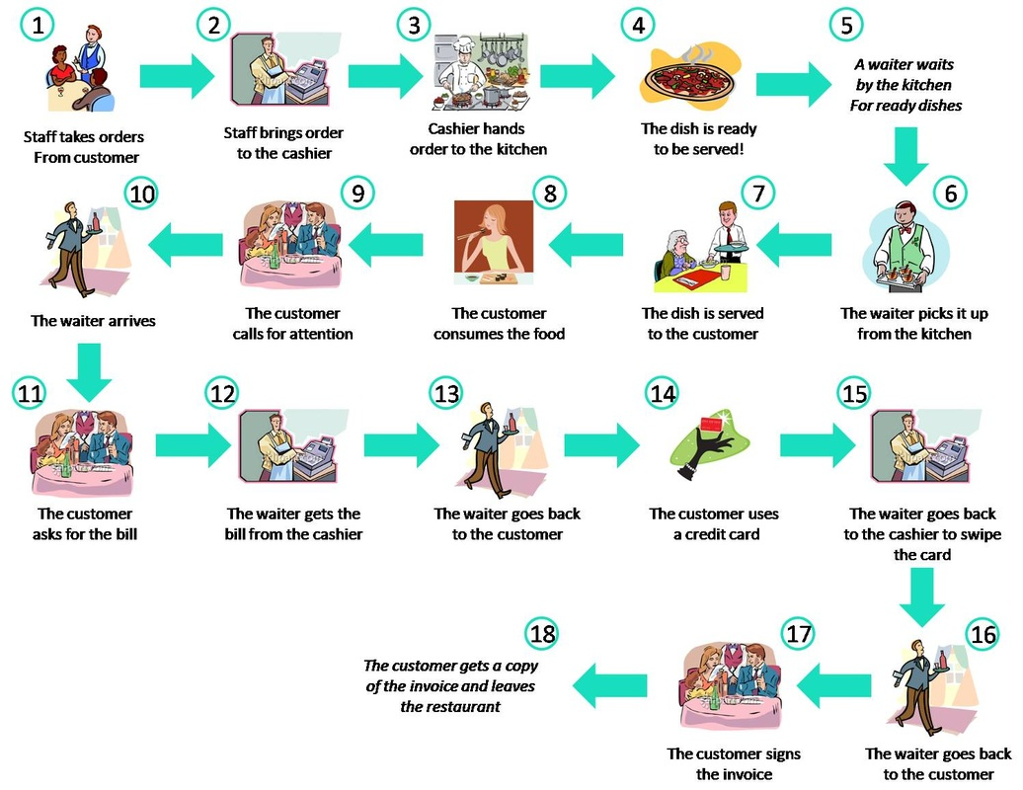
Problem Statement

Slide 8
Problem Statement
Shortage of manpower
Employee theft at the cashier
Mistakes in taking orders
Mistakes in delivering orders
Mistakes in billing
Mix ups in matching credit cards to the respective customers
Impatient customers queuing outside
Undergraduate Final Year Project Presentation
Dated: 12th November, 2016

Slide 9
Problem Statement
All these processes are labor intensive and prone to mistakes, as information is channeled from one person to another. It is also inefficient, as the staff is expected to multi-task in an environment where various requests and demands for attention comes in non-stop.
This stop-start-serve routine increases the turnaround time and results in conflicted priorities.
Undergraduate Final Year Project Presentation
Dated: 2nd October, 2016

Slide 10
Problem Statement
So the question that we put to the restaurant owners is
Would you like to be introduced to a user-friendly, inexpensive, time efficient and error free application to avoid all the existing chaos?
If your answer is an affirmative – then adopt are proposed alternative.
Undergraduate Final Year Project Presentation
Dated: 2nd October, 2016

Slide 11
Proposed Solution
PLC BASED SMART RESTAURANT
is an UN-INTERRUPTED delivery of food based on a low cost touch screen Restaurant Management System using PLC, RFID , Robotic arm , Conveyer belts and multi touch LCD modules
NOT ONLY THIS
Even the billing, pick and place of items and the return of the food utensils back to the kitchen are also automated. Resulting in a user-friendly, inexpensive, time efficient and error free application.

Slide 12
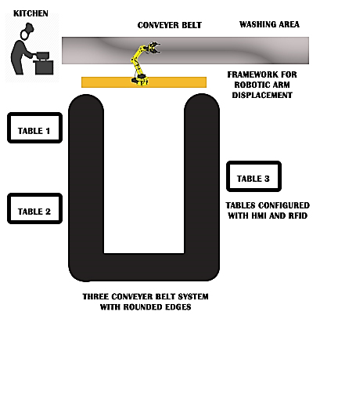
Block Diagram

Slide 13
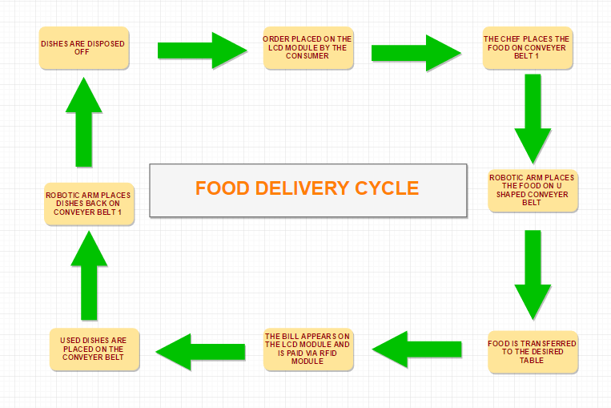
Flow Diagram

Slide 14
What we have done so far?:
PLC training from EESINT
-S7 300 PLC
-Basic Ladder Programming
-Use of PLC blocks
-Control of Conveyor Belts
Interfaced User HMI using PLC S7 1200 and Established connection b/w two HMIs.
Undergraduate Final Year Project Presentation
Dated: 12th November, 2016

Slide 15
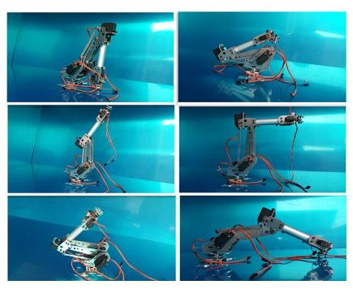
What have we done so far?:
Source of Basic idea

Slide 16
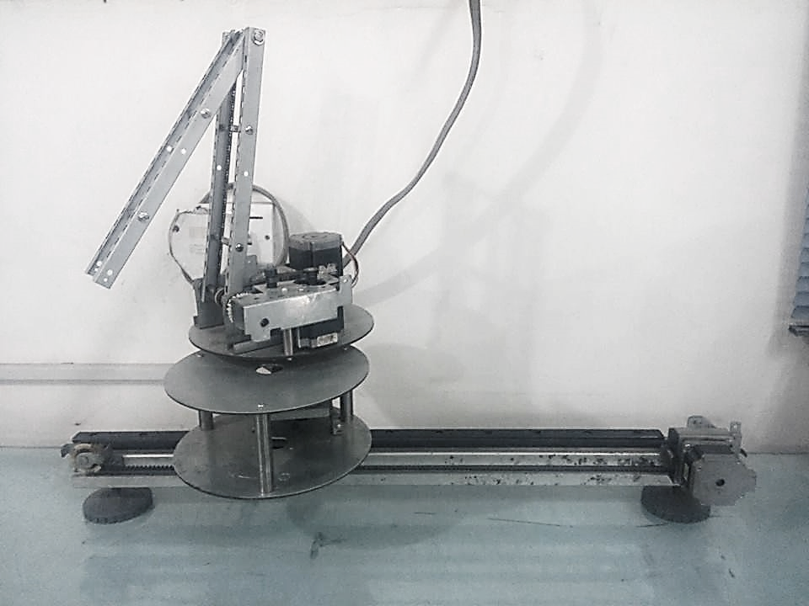
What have we done so far?:
Made Robotic Arm Assembly
Slider using Stepper
Jaw using Servo
4 Stepper Motors
(6 wire unipolar)

Slide 17
Problems Faced
HMI to PLC Interfacing
Acquisition Cycle
Robotic Arm Design
Combination of Rotary and Linear Motion with the robotic arm
Conveyor Belt Design
Rollers availability
Undergraduate Final Year Project Presentation
Dated: 12th November, 2016

Slide 18
Advantages
The idea of automation itself is marketable and is likely to attract more customers and , therefore, result in increased profit margins.
It will provide higher level jobs in the development, deployment, maintenance and running of the automated processes.
Improved robustness of the whole process.
No margin for human error in the whole process
Undergraduate Final Year Project Presentation
Dated: 12th November, 2016

Slide 19
Applications
Our whole assembly can be utilized in
-Sorting Systems in Industries
-RFID based luggage Sorting System in airports
-Footwear ordering system in shoe stores (it is nearly impossible to keep all sizes of the same design stacked up at one place infront of the customer so for that purpose our assembly can be utilized
Undergraduate Final Year Project Presentation
Dated: 12th November, 2016

Slide 20
Audience
Food industry - ever growing industry in Pakistan
- increased competition
Number of quality restaurants in Pakistan’s major cities
- Lahore = 456+ - Multan = 55+
- Karachi = 746+ - Gujranwala = 53+
- Islamabad = 209+ - Peshawar = 53+
- Rawalpindi = 98+ - Hyderabad = 27+
Undergraduate Final Year Project Presentation
Dated: 12th November, 2016

Slide 21
Future Deliverables
A prototype of Smart Restaurant that includes:
Pick and Place Robotic Assembly
RFID Card Based Identity and Billing
Conveyor Belts
Configuration of sensors for accurate user table detection
Undergraduate Final Year Project Presentation
Dated: 12th November, 2016

Slide 22
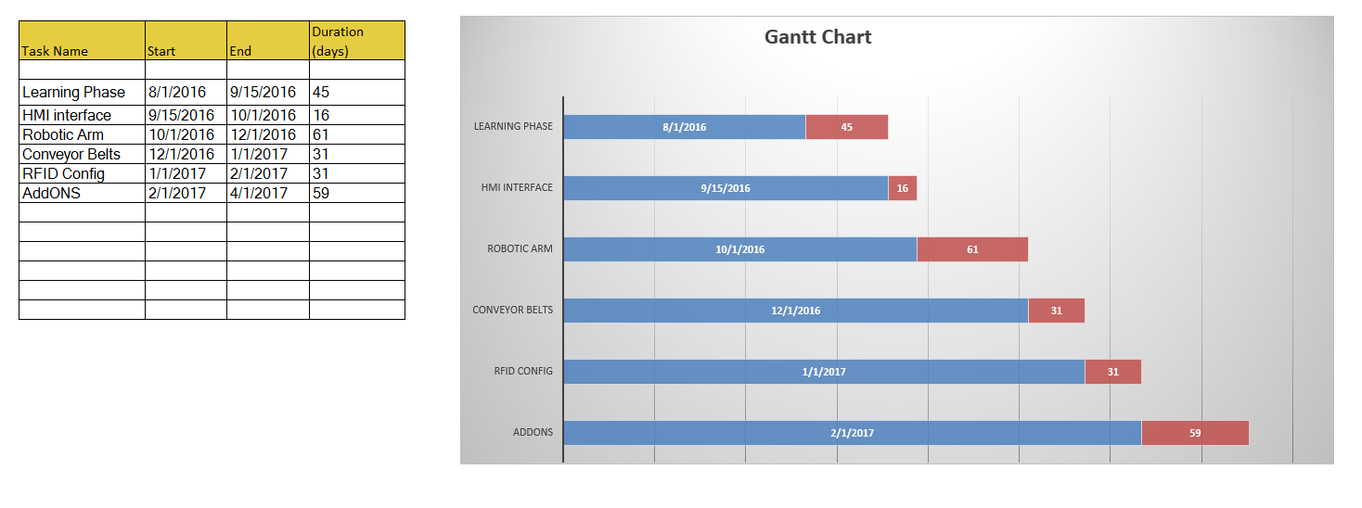
Gantt Chart
Undergraduate Final Year Project Presentation
Dated: 12th November, 2016

Slide 23
References
http://www.thesmartrestaurantproject.com/the-project.html
http://pakistani.pk/category/restaurants
Undergraduate Final Year Project Presentation
Dated: 12th November, 2016

Slide 24
Undergraduate Final Year Project Presentation
Dated: 12th November, 2016

