Slide 1
Design and Implementation of On Board Computer of Micro LEO Satellite
Group No: 40
Project Advisor: Dr. Muhammad Tahir
Department of Electrical Engineering,
University of Engineering and Technology, Lahore
Undergraduate Final Year Project Presentation
Dated: 8th November, 2016

Slide 2
Team Introduction
Umair Riaz (Team Leader)
2013-EE-113
Specialization: Computer
Muhammad Huzaifa Bashir
2013-EE-125
Specialization: Computer
Muhammad Azeem Awan
2013-EE-111
Specialization: Computer
Muhammad Nabeel Tahir
2013-EE-139
Specialization: Computer
Undergraduate Final Year Project Presentation
Dated: 8th November, 2016

Slide 3
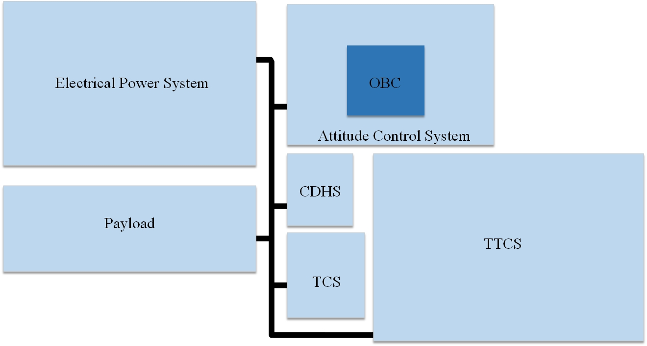
System Level Diagram of PNSS-1
Undergraduate Final Year Project Presentation
Dated: 8th November, 2016

Slide 4
Problem Statement
Complete attitude control of satellite
Hardware design for harsh space conditions
Fault tolerant design
Power efficient design of OBC
Simplicity
Undergraduate Final Year Project Presentation
Dated: 8th November, 2016

Slide 5
Proposed Solution
Attitude Control
Periodic sensor data acquisition
Processing by control algorithms for error calculation
Commanding the actuators to minimize the error
Selection of space compatible components
Latch up protection of components
EMI filtration
Harsh Space Conditions
Undergraduate Final Year Project Presentation
Dated: 8th November, 2016

Slide 6
Proposed Solution
Fault Tolerant Design
Use of Fault Tolerant Module (FTM)
Physical redundancy at component and module level
Power Efficient Design
Use of ultra low power components
Simplicity
Use of dedicated interfaces for different tasks
Maximum use of discrete components
Undergraduate Final Year Project Presentation
Dated: 8th November, 2016

Slide 7
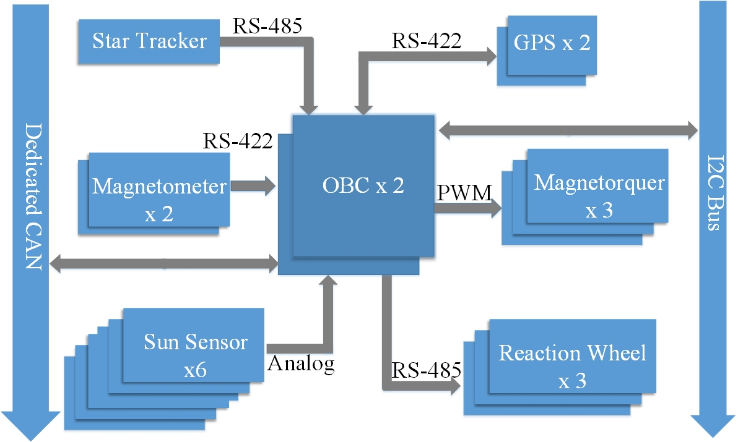
Block Diagram
Interfaces of OBC
Undergraduate Final Year Project Presentation
Dated: 8th November, 2016

Slide 8
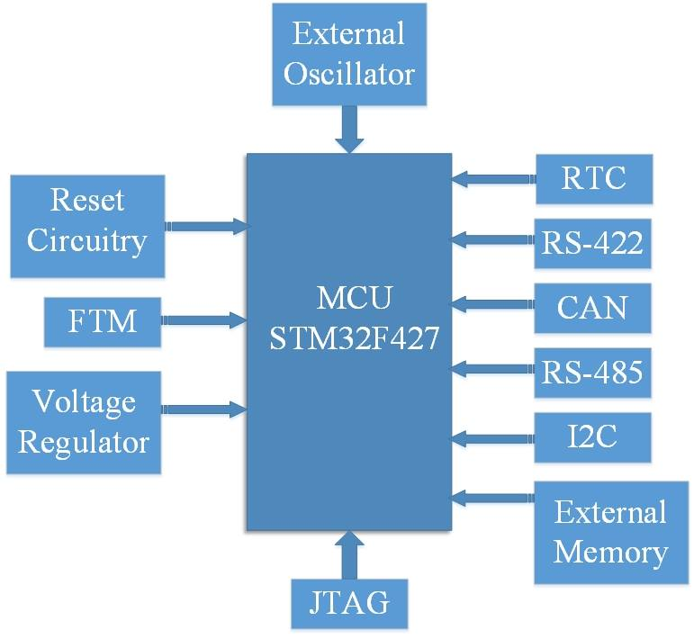
Block Diagram
Internal Block Diagram of OBC
Undergraduate Final Year Project Presentation
Dated: 8th November, 2016

Slide 9
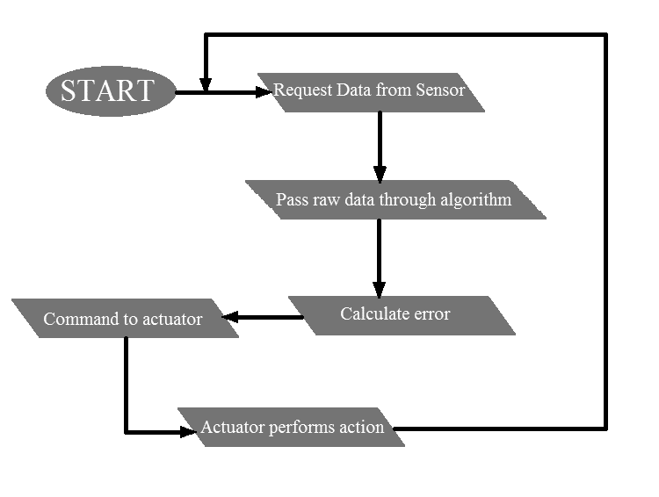
Flow Diagram
Attitude Control Process
Undergraduate Final Year Project Presentation
Dated: 8th November, 2016

Slide 10
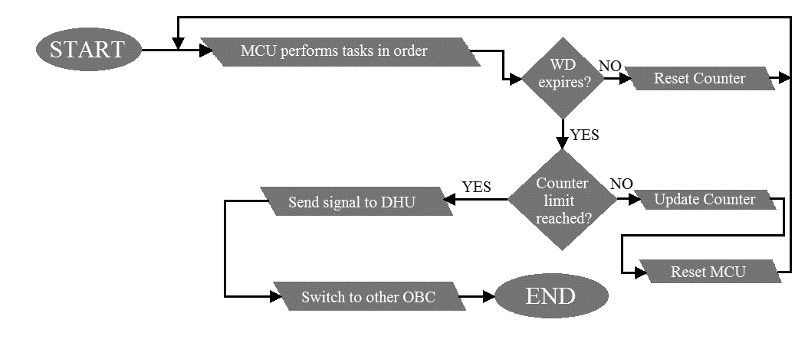
Flow Diagram
Reset and FTM flow diagram
Undergraduate Final Year Project Presentation
Dated: 8th November, 2016

Slide 11
Applications
Use in space crafts, satellites and rockets
Automotive applications
Robotics and automation
Undergraduate Final Year Project Presentation
Dated: 8th November, 2016

Slide 12
Audience
Space industry
Pakistani students interested in space technology
Space programs of third world countries
Undergraduate Final Year Project Presentation
Dated: 8th November, 2016

Slide 13
What have we done so far?:
Review of unit requirement and system design documents
Demonstration to SUPARCO officials
CAN multi-node configuration
RS422 configuration
Watchdog timer configuration
Undergraduate Final Year Project Presentation
Dated: 8th November, 2016

Slide 14
What have we done so far?:
Circuit design of various modules of OBC
Voltage regulation with EMI filtration
Reset circuit
Fault Tolerant Module(FTM)
Clock and processor
Communication interfaces
Component selection
Schematic design of OBC
Undergraduate Final Year Project Presentation
Dated: 8th November, 2016

Slide 15
Improvement in Seniors’ Work:
Processor has been changed according to requirements
Change in firmware
Change of many components
Reset circuit has been included
FTM module has been included
Communication circuits have been changed
EMI filtration has been included
Undergraduate Final Year Project Presentation
Dated: 8th November, 2016

Slide 16
Hardware Developed:
Due to non-disclosure agreement with SUPARCO, design cannot be displayed before completion.
Undergraduate Final Year Project Presentation
Dated: 8th November, 2016

Slide 17
Future Deliverables
PCB fabrication
Procurement of components
Firmware development
Attitude control demonstration
Undergraduate Final Year Project Presentation
Dated: 8th November, 2016

Slide 18
Gantt Chart
Undergraduate Final Year Project Presentation
Dated: 8th November, 2016

Slide 19
References
SUPARCO documents
Data sheets of various components
Microprocessor reference manual
Development of OBC Systems by A.E. Cooper and W.T Chow
Websites
http://www.circuitstoday.com/filter-circuits
Undergraduate Final Year Project Presentation
Dated: 8th November, 2016

