Slide 1
Power Factor Improvement Using Static VAR Compensator
Group No: 2013-FYP-30
Project Advisor: Dr. Umer Tabrez Shami
Department of Electrical Engineering,
University of Engineering and Technology, Lahore
Undergraduate Final Year Project Presentation
Dated: 8th November, 2016

Slide 2
Team Introduction
Muhammad Arshed (Team Leader)
2013-EE-138
Specialization: Power Engineering
Muhammad Sohail
2013-EE-96
Specialization: Power Engineering
Sadia Naseer
2013-EE-58
Specialization: Power Engineering
Faheem Zafar
2013-EE-188
Specialization: Power Engineering
Undergraduate Final Year Project Presentation
Dated: 8th November, 2016

Slide 3
Problem Statement
If the power factor is low then following problems occur:
Useful power which is active power is low.
Consumer has to face penalty.
Generator which is supplying power, has to face more loading.
Undergraduate Final Year Project Presentation
Dated: 8th November, 2016

Slide 4
Problem Solution
The solution of these problems is to improve power factor, which can be done by three ways:
Using Static VAR compensator
Using Synchronous Condenser
Using Phase Advancer
Undergraduate Final Year Project Presentation
Dated: 8th November, 2016

Slide 5
Problem Solution
We are using Static VAR Compensator for power factor improvement because:
It has low losses
It requires less maintenance as there is no rotating part
It can be easily installed as it is light
Below 500KVA rating, cost of synchronous condenser is greater than static VAR compensator
Phase advancers are not economical for motor of ratings below 200HP
Undergraduate Final Year Project Presentation
Dated: 8th November, 2016

Slide 6
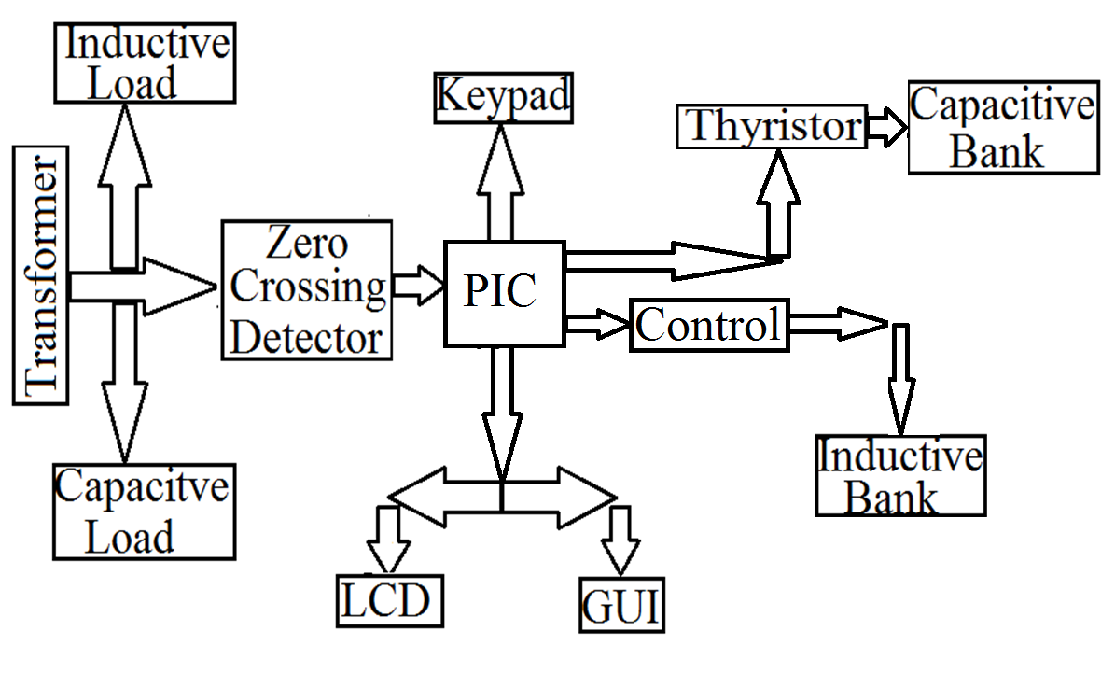
Block Diagram
Undergraduate Final Year Project Presentation
Dated: 8th November, 2016

Slide 7
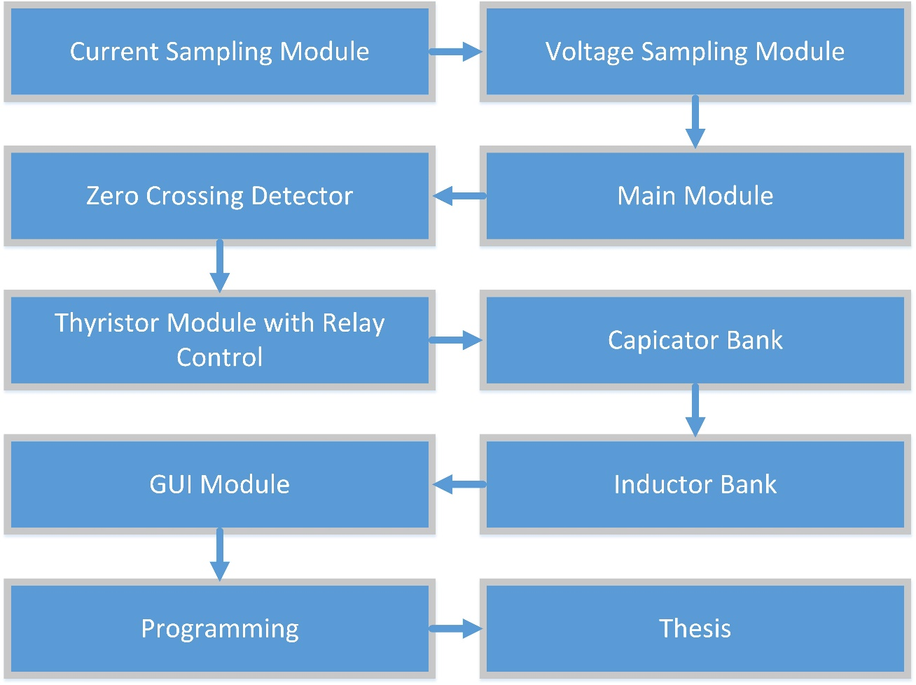
Flow Diagram
Undergraduate Final Year Project Presentation
Dated: 8th November, 2016

Slide 8
Applications
Static VAR Compensator is used:
For reactive power compensation
For voltage stabilization
For harmonic Reduction
To increase the system capacity
To increase productivity
Undergraduate Final Year Project Presentation
Dated: 8th November, 2016

Slide 9
Audience
Steel making plants
Grid stations
Cutting tool industries
Large rolling mills
Service feeders
Undergraduate Final Year Project Presentation
Dated: 8th November, 2016

Slide 10
What we have done so far?:
Simulation of voltage sampling module:
A variable resistor is used to adjust the value suitable for comparison at the controller.
Undergraduate Final Year Project Presentation
Dated: 8th November, 2016

Slide 11
What we have done so far?
Simulation of current sampling module:
The simulation of current sampling module is shown below. A variable resistor is used to adjust the value of current suitable for comparison at the controller.
Undergraduate Final Year Project Presentation
Dated: 8th November, 2016

Slide 12
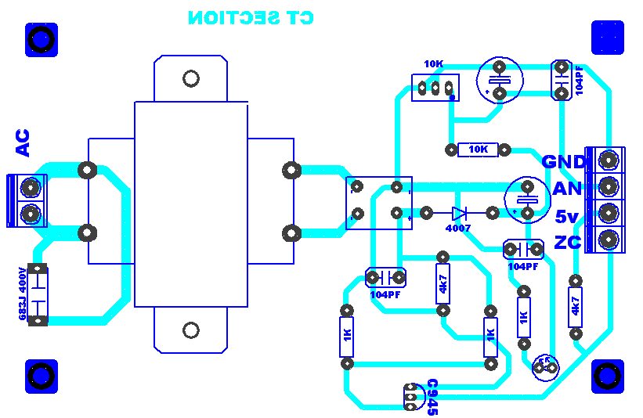
PCB Layout of Voltage Sampling Module
Undergraduate Final Year Project Presentation
Dated: 8th November, 2016

Slide 13
PCB Layout of Current Sampling Module
Undergraduate Final Year Project Presentation
Dated: 8th November, 2016

Slide 14
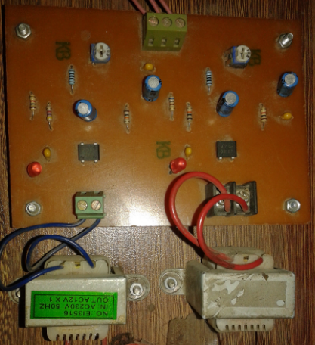
Hardware of current and voltage Sampling Module
Undergraduate Final Year Project Presentation
Dated: 8th November, 2016

Slide 15
Future Deliverables
Development of different sub modules for improving the power factor which consists of:
Zero Crossing Detector
Microcontroller & LCD interface (main board)
Thyristor Module with relay control
Capacitor bank
Inductive bank
GUI module
Undergraduate Final Year Project Presentation
Dated: 8th November, 2016

Slide 16
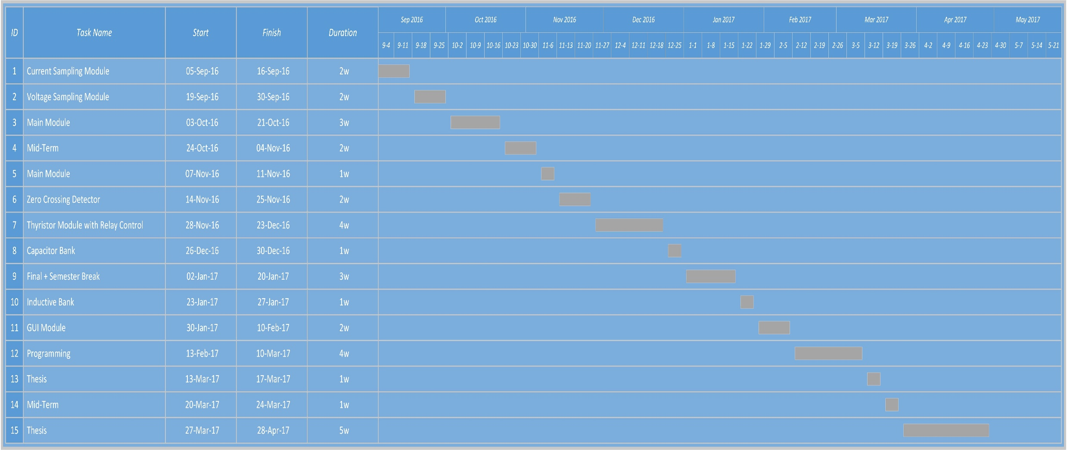
Gantt Chart
Undergraduate Final Year Project Presentation
Dated: 8th November, 2016

Slide 17
References
Haroon M. Rashid, 2015,. Power electronics devices, circuits and applications
V. Mehta K., Power System Analysis
Ware J., Power factor correction
http://en.wikipedia.org/wiki/StaticVARcompensator
Undergraduate Final Year Project Presentation
Dated: 8th November, 2016

