Slide 1
3D-Mapping Autonomous Flight Quadcopter with Inductive Charging
Group No: 07
Project Advisor: Dr. Khalid Mehmood ul Hasan
Department of Electrical Engineering,
University of Engineering and Technology, Lahore
Undergraduate Final Year Project Presentation
Dated: 7th November, 2016

Slide 2
Team Introduction
Muhammad Ayaz Qureshi (Team Leader)
2013-EE-027
Specialization: Power
Muhammad Ismail Saleem
2013-EE-029
Specialization: Power
Wajid Ali
2013-EE-035
Specialization: Power
Hummad Ahmad Usmani
2013-EE-046
Specialization: Power
Undergraduate Final Year Project Presentation
Dated: 7th November, 2016

Slide 3
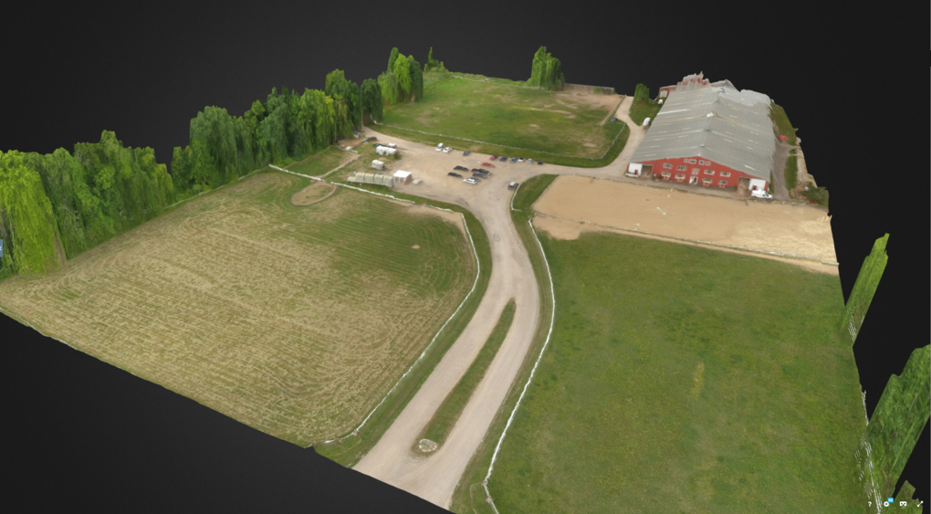
Title Breakdown
3D Mapping
Developing 3D Models from still pictures, taken from above, of the desired area for off-site surveying and future reference.
Undergraduate Final Year Project Presentation
Dated: 7th November, 2016

Slide 4
Title Breakdown
Inductive Charging
Enabling the system to be totally independent in terms of power requirements of the system, apart from regular maintenance.
Autonomous Flight
Enabling the system to navigate through the environment avoiding any obstacles without any assistance from user-end.
Undergraduate Final Year Project Presentation
Dated: 7th November, 2016

Slide 5
Problem Statement
With the advancement in technologies the use of autonomous robots in industry, households and surveillance systems is increasing rapidly . Due to the limitations of GPS technology, it cannot be used for indoor navigations which are usually termed as GPS-denied environments. This poses a problem for robots to navigate through a certain indoor environment without any knowledge of its surroundings pertaining to its specific location.
Undergraduate Final Year Project Presentation
Dated: 7th November, 2016

Slide 6
Proposed Solution
Our project aims at developing a system which will be fully autonomous in outdoor and essentially indoor environments. For outdoor environments, GPS system is quite accurate and can be used efficiently. For indoor environments, SLAM (Simultaneous localization and Mapping) Algorithms along with laser rangefinder sensors, are quite effective. This is certainly a challenging task to accomplish due to sensor limitations.
Undergraduate Final Year Project Presentation
Dated: 7th November, 2016

Slide 7
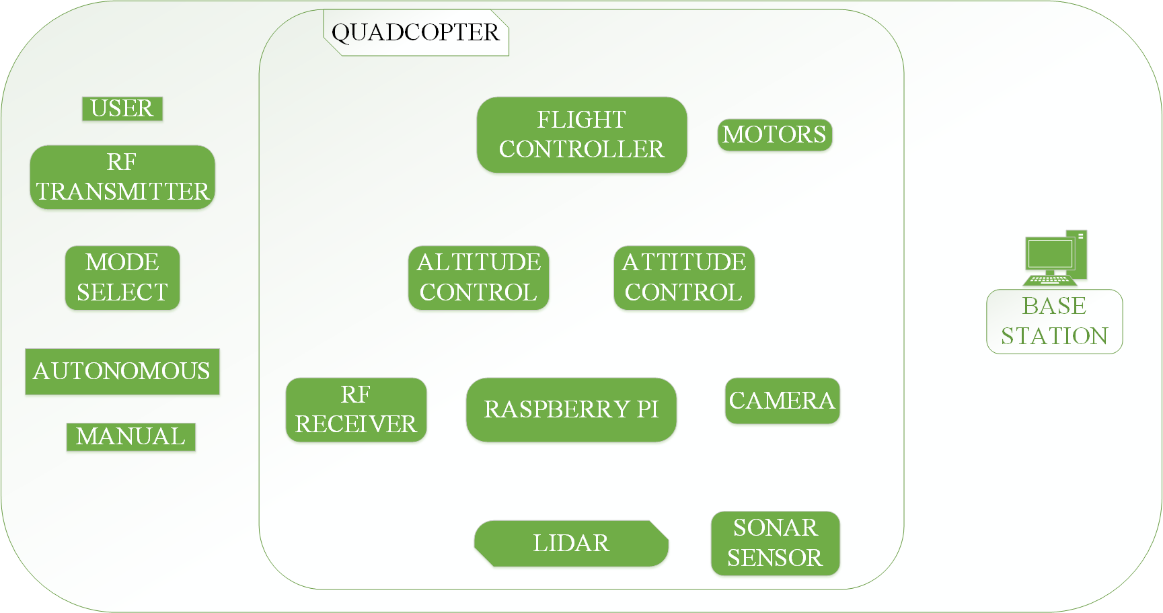
Block Diagram
Undergraduate Final Year Project Presentation
Dated: 7th November, 2016

Slide 8
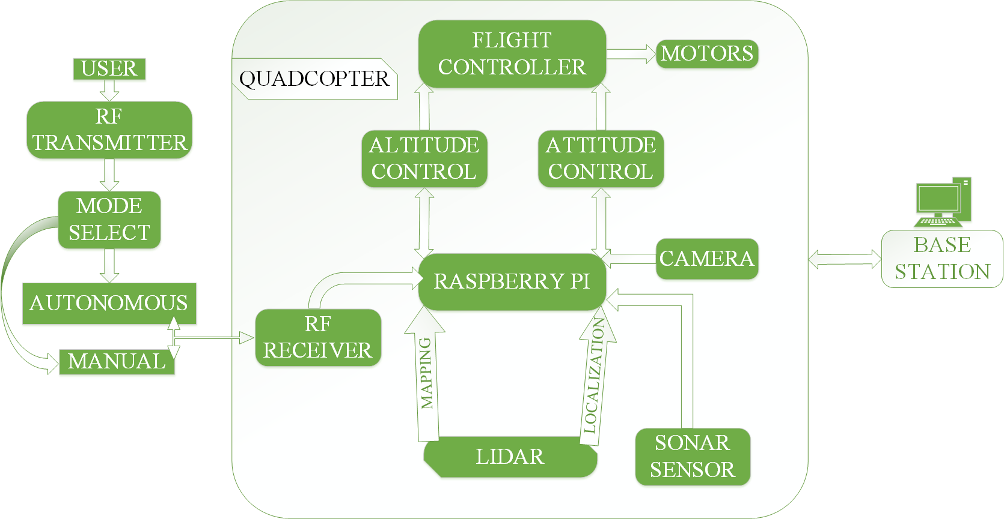
Flow Diagram
Undergraduate Final Year Project Presentation
Dated: 7th November, 2016

Slide 9
Applications
For surveillance of indoor and outdoor environments using camera.
For developing 3D models assisting in off-site surveying.
Transmission line Mechanical fault detection.
First Aid Kit Dispatch.
Traffic Analysis
Cargo Delivery
Undergraduate Final Year Project Presentation
Dated: 7th November, 2016

Slide 10
Audience
Autonomy is a widely researched topic all around the world in the field of robotics. Our audience can be any (or all, depending on the application requirement) of the following:
Industry
Security Department
Distribution Companies
Undergraduate Final Year Project Presentation
Dated: 7th November, 2016

Slide 11
What we have done so far?:
A 3D point cloud from 2 views(pictures) has been generated using OpenCV libraries.
Maiden Flight of Quadcopter.
Undergraduate Final Year Project Presentation
Dated: 7th November, 2016

Slide 12
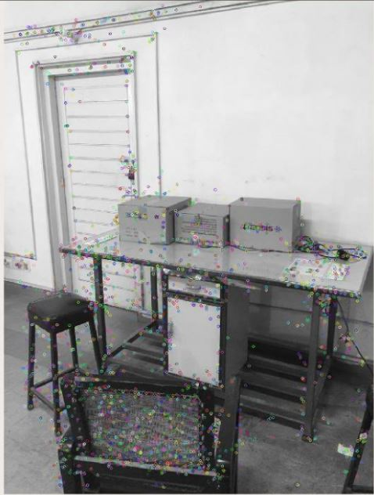
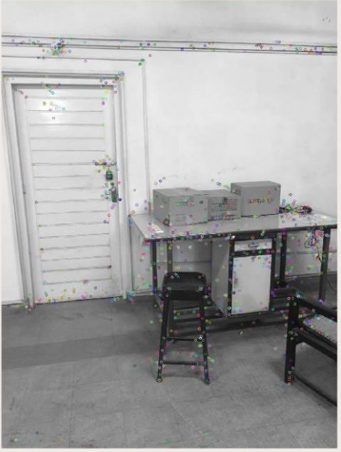
Undergraduate Final Year Project Presentation
Dated: 7th November, 2016

Slide 13
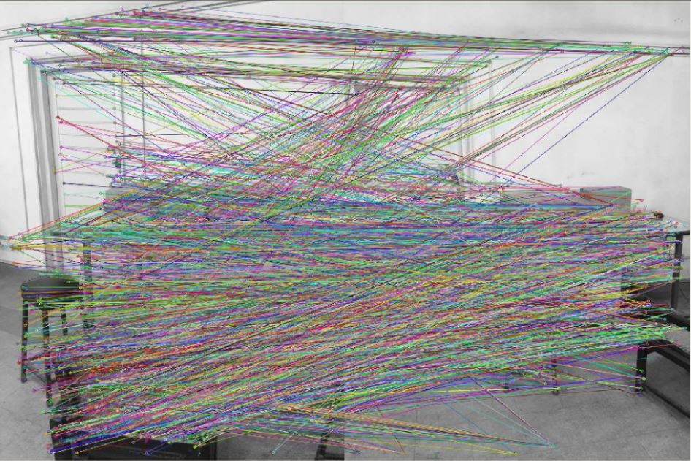
Undergraduate Final Year Project Presentation
Dated: 7th November, 2016

Slide 14
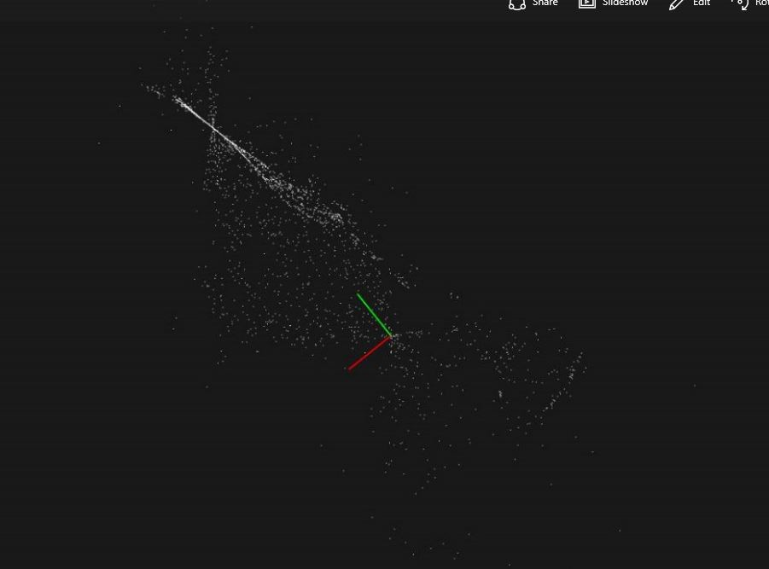
Undergraduate Final Year Project Presentation
Dated: 7th November, 2016

Slide 15
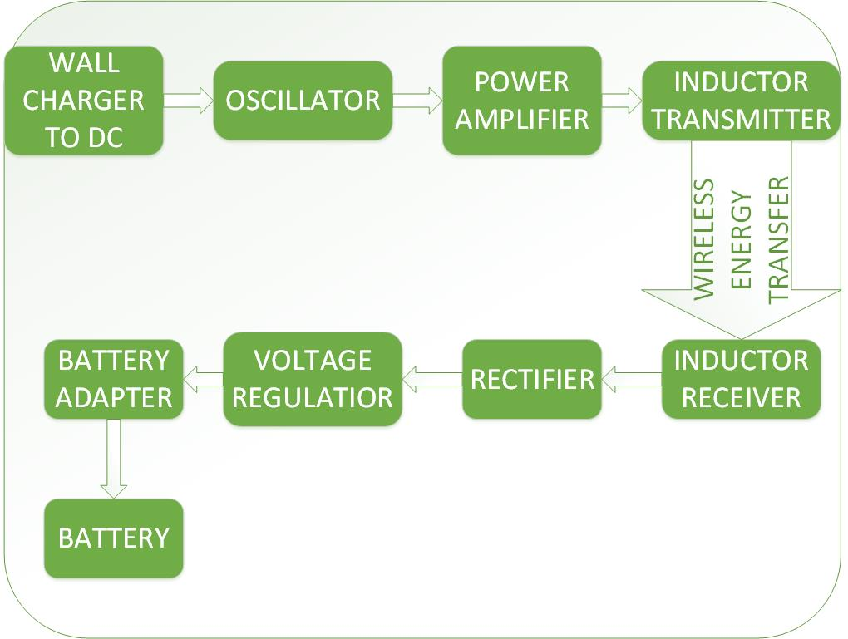
What we have done so far?:
Inductive power transmission between transmitting and receiving air core coils at a separation of almost 7-10 cm. (12 V and 9 mA transmission between coils )
Undergraduate Final Year Project Presentation
Dated: 7th November, 2016

Slide 16
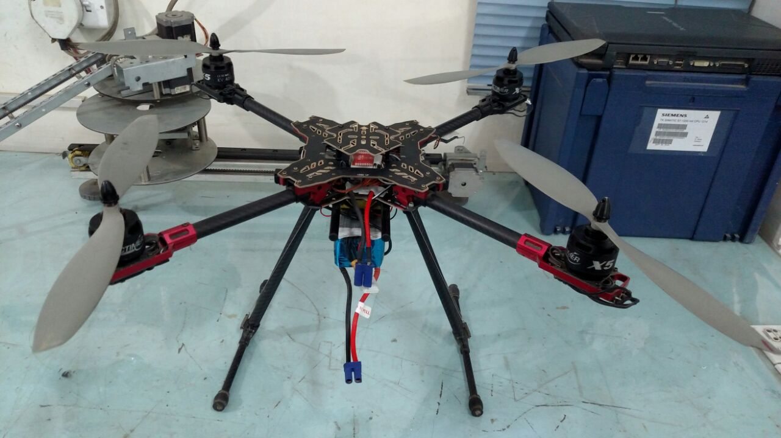
Hardware Developed
Undergraduate Final Year Project Presentation
Dated: 7th November, 2016

Slide 17
Future Deliverables
Generating a refined 3D model from multiple pictures of the scene.
Implementation of SLAM Algorithm to estimate indoor environment and position for autonomous flight.
Achieving at least 2A current at the receiving end of Wireless Charging Circuitry.
Undergraduate Final Year Project Presentation
Dated: 7th November, 2016

Slide 18
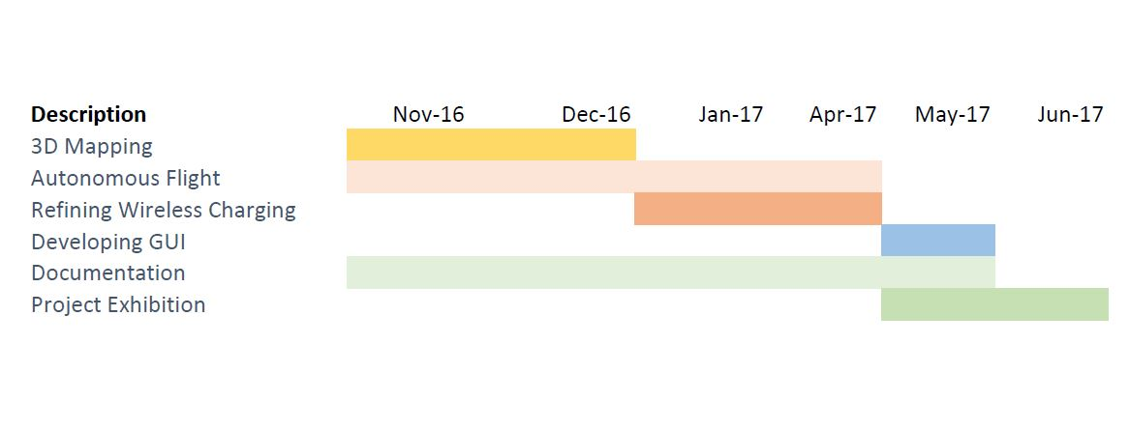
Gantt Chart
Undergraduate Final Year Project Presentation
Dated: 7th November, 2016

Slide 19
References
[1] D. Baggio, S. Emami, M. Escrivá and N. Mahmood, Mastering OpenCV with Practical Computer Vision Projects, Birmingham: PACKT Publishing Ltd., 2012. Books
[2] "GIS LOUNGE," [Online]. Available: https://www.gislounge.com/robotic-mapping-simultaneous-localization-and-mapping-slam/. [Accessed 2016].
[3] "GitHub," [Online]. Available: https://github.com/. [Accessed 2016].
Undergraduate Final Year Project Presentation
Dated: 7th November, 2016

