Slide 1
COMPUTER CONTROLLED THREE PHASE AC MULTI-LEVEL INVERTER DRIVE
Group No: 2013-FYP-43
Project Advisor: Dr. Umer Tabraiz Shami
Department of Electrical Engineering,
University of Engineering and Technology, Lahore
Undergraduate Final Year Project Presentation
Dated: 9th November, 2016

Slide 2
Team Introduction
Tabish Aftab (Team Leader)
2013-EE-187
Specialization: Power
Shahryar Ahsan
2013-EE-193
Specialization: Power
Undergraduate Final Year Project Presentation
Dated: 8th November, 2016

Slide 3
Problem Statement
A Variable speed drive (VSD) plays an important role not only in industrial applications but also in
offshore applications, where high reliability is requested for subsea applications. Variable speed
drives are commonly used for energy saving and in some applications an increasing of the
productivity is achieved.
Undergraduate Final Year Project Presentation
Dated: 8th November, 2016

Slide 4
Problem Statement
The industry has begun to demand higher power equipment and for this reason the VSD technology has experienced rapid changes towards improvement. The use of multilevel inverters has emerged as the solution for working with higher voltage levels being an
attractive solution to control ac drives in the megawatt range.

Slide 5
Problem Statement
Subsea drives have become the new trend of the drives technologies in the oil and gas sector. Currently and in order to have the drive close to the load avoiding a long cable between them, the design of new subsea technologies are relevant for the companies.

Slide 6
Proposed Solution
This work deals with analyses of the control for a subsea drive with multilevel inverter. The use of those drives have become the new trend for using of pumps/compressors at minor oil and gas reservoirs located far away from existing platforms.
Undergraduate Final Year Project Presentation
Dated: 8th November, 2016

Slide 7
Proposed Solution
It is developed a general model for analyzing a variable speed drive with a multilevel inverter with the objective to verify the response of two control methods for a specific application.
The simulation model is used to identify the performance of both methods in terms of speed response, torque ripple and transient behavior.

Slide 8
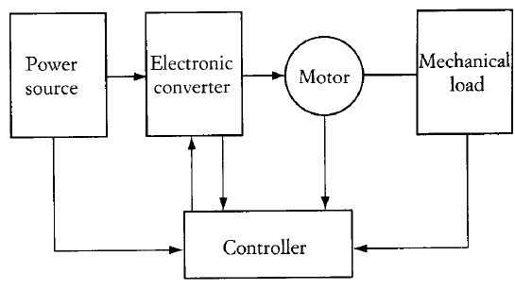
Block Diagram

Slide 9
Inverters

Slide 10
Multi-Level Inverters

Slide 11
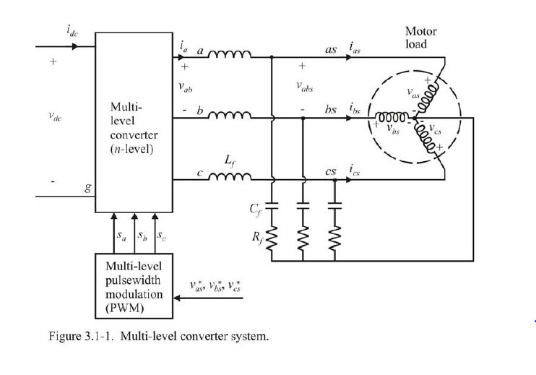
Multi-Level Circuitry

Slide 12
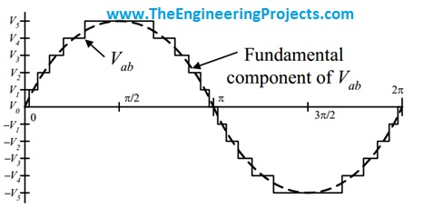
Behavior

Slide 13
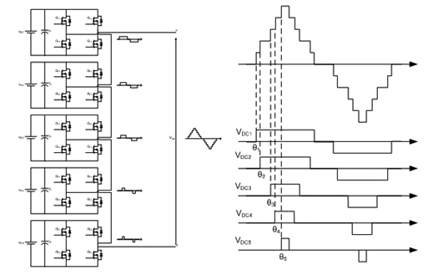
Waveforms

Slide 14
Hardware Model

Slide 15
Applications
Long cable lengths contribute to a damped high frequency ringing at the motor terminals due to the distributed nature of the cable leakage inductance coupling capacitance (LC), which result in overvoltage and further stress the motor insulation.
Undergraduate Final Year Project Presentation
Dated: 2nd October, 2016

Slide 16
Variable speed drives provide flexible control on the operation of subsea systems with typical operating frequency ranging between 50 and 70 Hz, but the harmonics generated at the output of a VFD could interact with the subsea cable and create a series resonance condition at the load side of the drive.
The impedance of the subsea cable could introduce a significant voltage drop during motor starting and cause the motor starting difficulty if the subsea pump system is not properly designed.

Slide 17
Future Prospects
Since multilevel inverter fed motor drives have gained special attention in the industry and academia as the preferred choice of electronic power conversion for high power applications, there are still quite a few important aspects to be solved.
The conventional PWM modulation technique was implemented for both control methods. A comparison with base on space vector modulation technique should be analyzed in order to see the advantages and/or drawbacks in the control performance.

Slide 18
References
P. W. Hammond, “A New Approach to Enhance Power Quality for Medium Voltage AC Drives,” IEEE Trans. on Ind. Appl., January-February 1997, vol. 33, no. 1.
S. Malik and D. Kluge, “ACS 1000—World’s first standard AC drive for medium voltage Applications,” ABB Rev., 1998, no. 2, pp. 4-11. S.S. Fazel, D. Krug, T. Taleb, and S. Bernet, “Comparison of Power Semiconductor
Utilization, Losses and Harmonic Spectrum of State-of-the-Art 4.16kV Multi-Level Voltage Source Converters,” in EPE Conf. Rec., Dresden, Germany, 2005.
Siemens drives website: www.automation.siemens.com
Undergraduate Final Year Project Presentation
Dated: 2nd October, 2016

