Slide 1

FYP Presentation
Project Supervisor:
Dr. Muhammad Tahir

Slide 2
Team Introduction
Taimur Bilal(Team Leader) Muhammad Ibrahim Qureshi
2013-EE-161 2013-EE-174
Computer and Electronics Telecom and Electronics
Zahra Zulfiqar Hassaan Khalid
2013-EE-105 2013-EE-189
Computer Computer

Slide 3
Problem Statement
Recent Terrorist Attacks
Potential Threats at Institutes and Organizations’ Entrances
Eminent Loss of Security Personnel and Civilians

Slide 4
Proposed Solution
Fully Autonomous Machine

Slide 5

Is it really possible?
Intention Detection System?

Slide 6
Proposed Solution
Fully Autonomous Machine
Super-imposing Human Decision Making
A handshake between Man and Machine

Slide 7
TLD based Semi-Autonomous Machine
Best of both Worlds…!

Slide 8
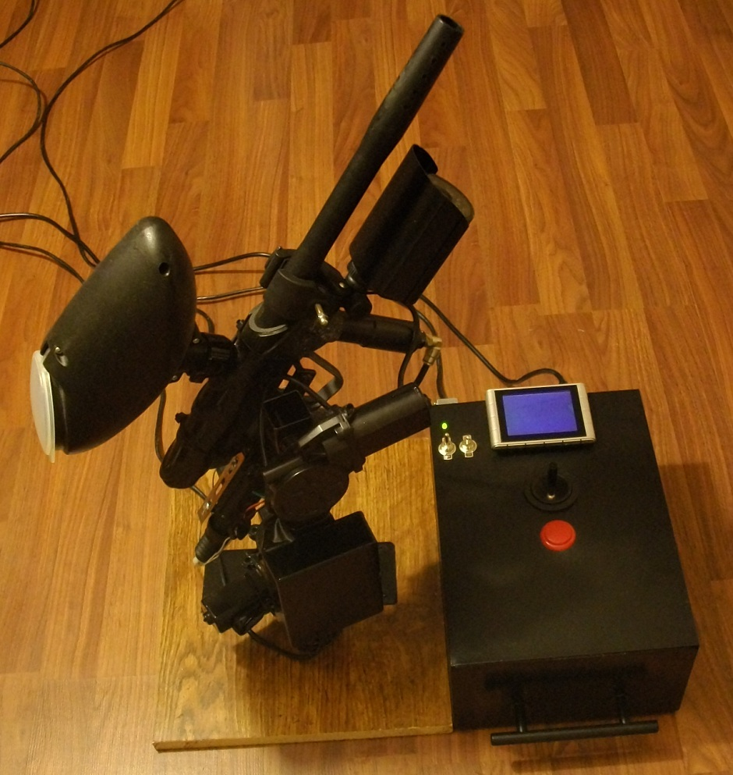

Slide 9
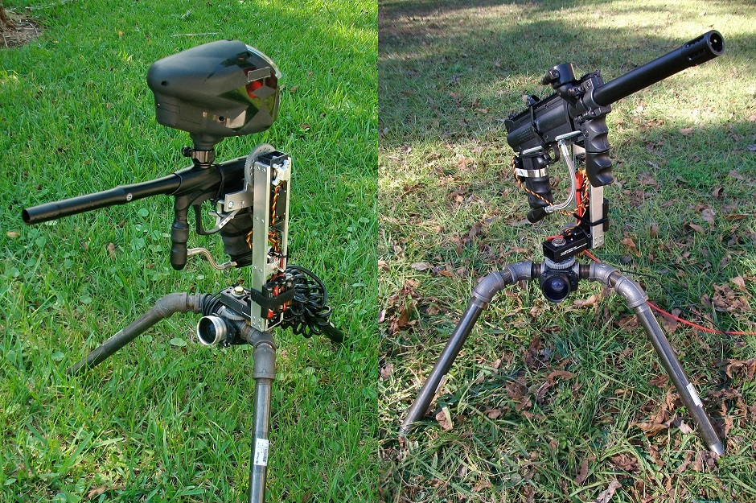

Slide 10
Flow Diagram

Slide 12
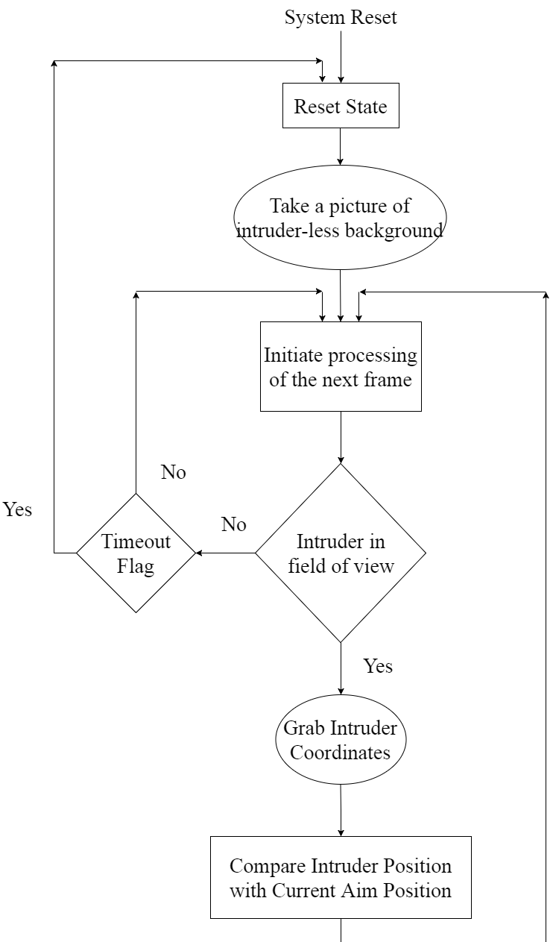

Slide 13
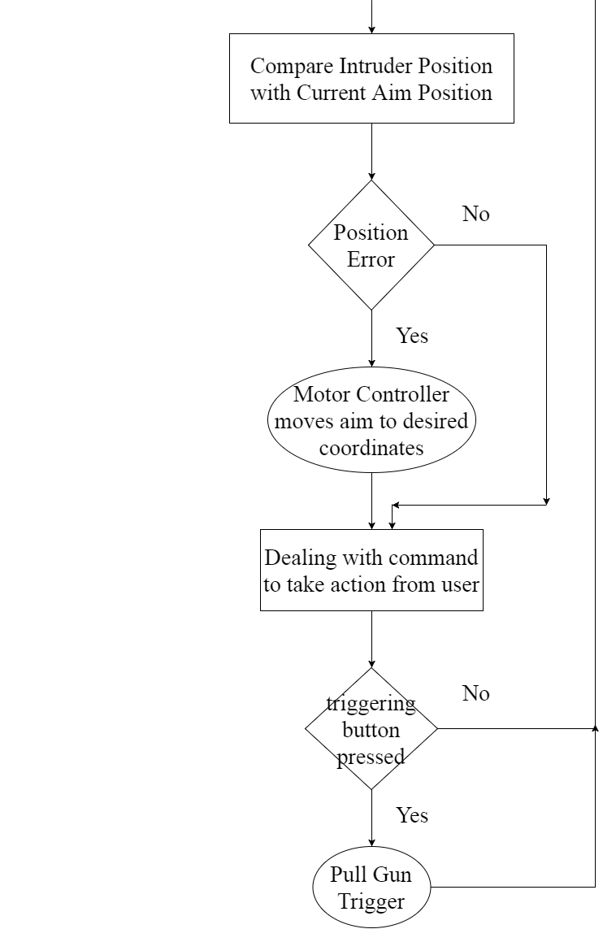

Slide 14
Block Diagram

Slide 16
Applications
Wall of Defence against Terrorists
De-Militarized Zones(DMZ)
Military Training (Australian Navy) [1]
Advanced Security Systems

Slide 17
Other Applications
GPS based Tracking
Autonomous fire fighting
Highly accurate PCB production
CNC machines
3D printing

Slide 18
Audience
Defence Industries
Clients of Automated Surveillance and Security Systems
High-Tech Research Centres

Slide 19
Work Done
Devising Workplan
Learning Image Processing on Linux
Selecting Micro-Controller Boards

Slide 20
Work Done
Installing OS and required Drivers for OpenCV
Execution of Sample Codes
Open TLD source code Implementation

Slide 21
Work Done
Study about PMAC
Executing Commands on Terminal
Utilization of Watch Window
Tuning Gains to get better Response of Motors
Controlling Multiple Motors Individually

Slide 22
Hardware Developed
Camera Integration with Odroid XU4 Board
PMAC Motor Controller for Coordinated Motion

Slide 23
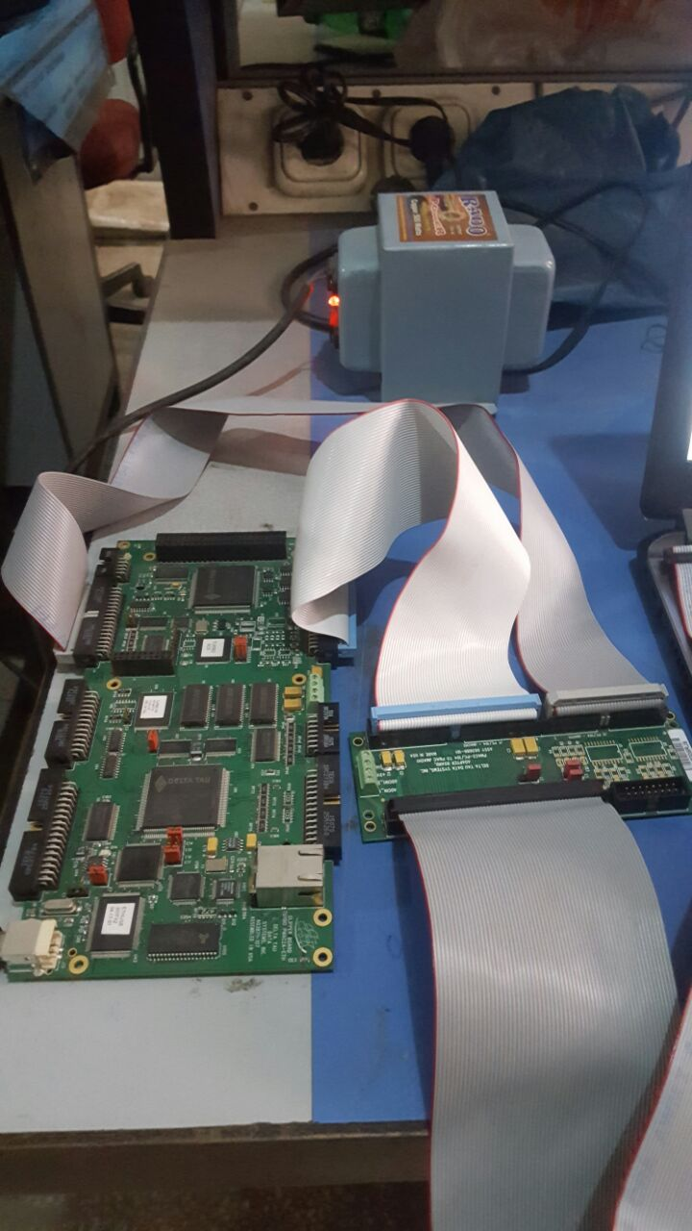
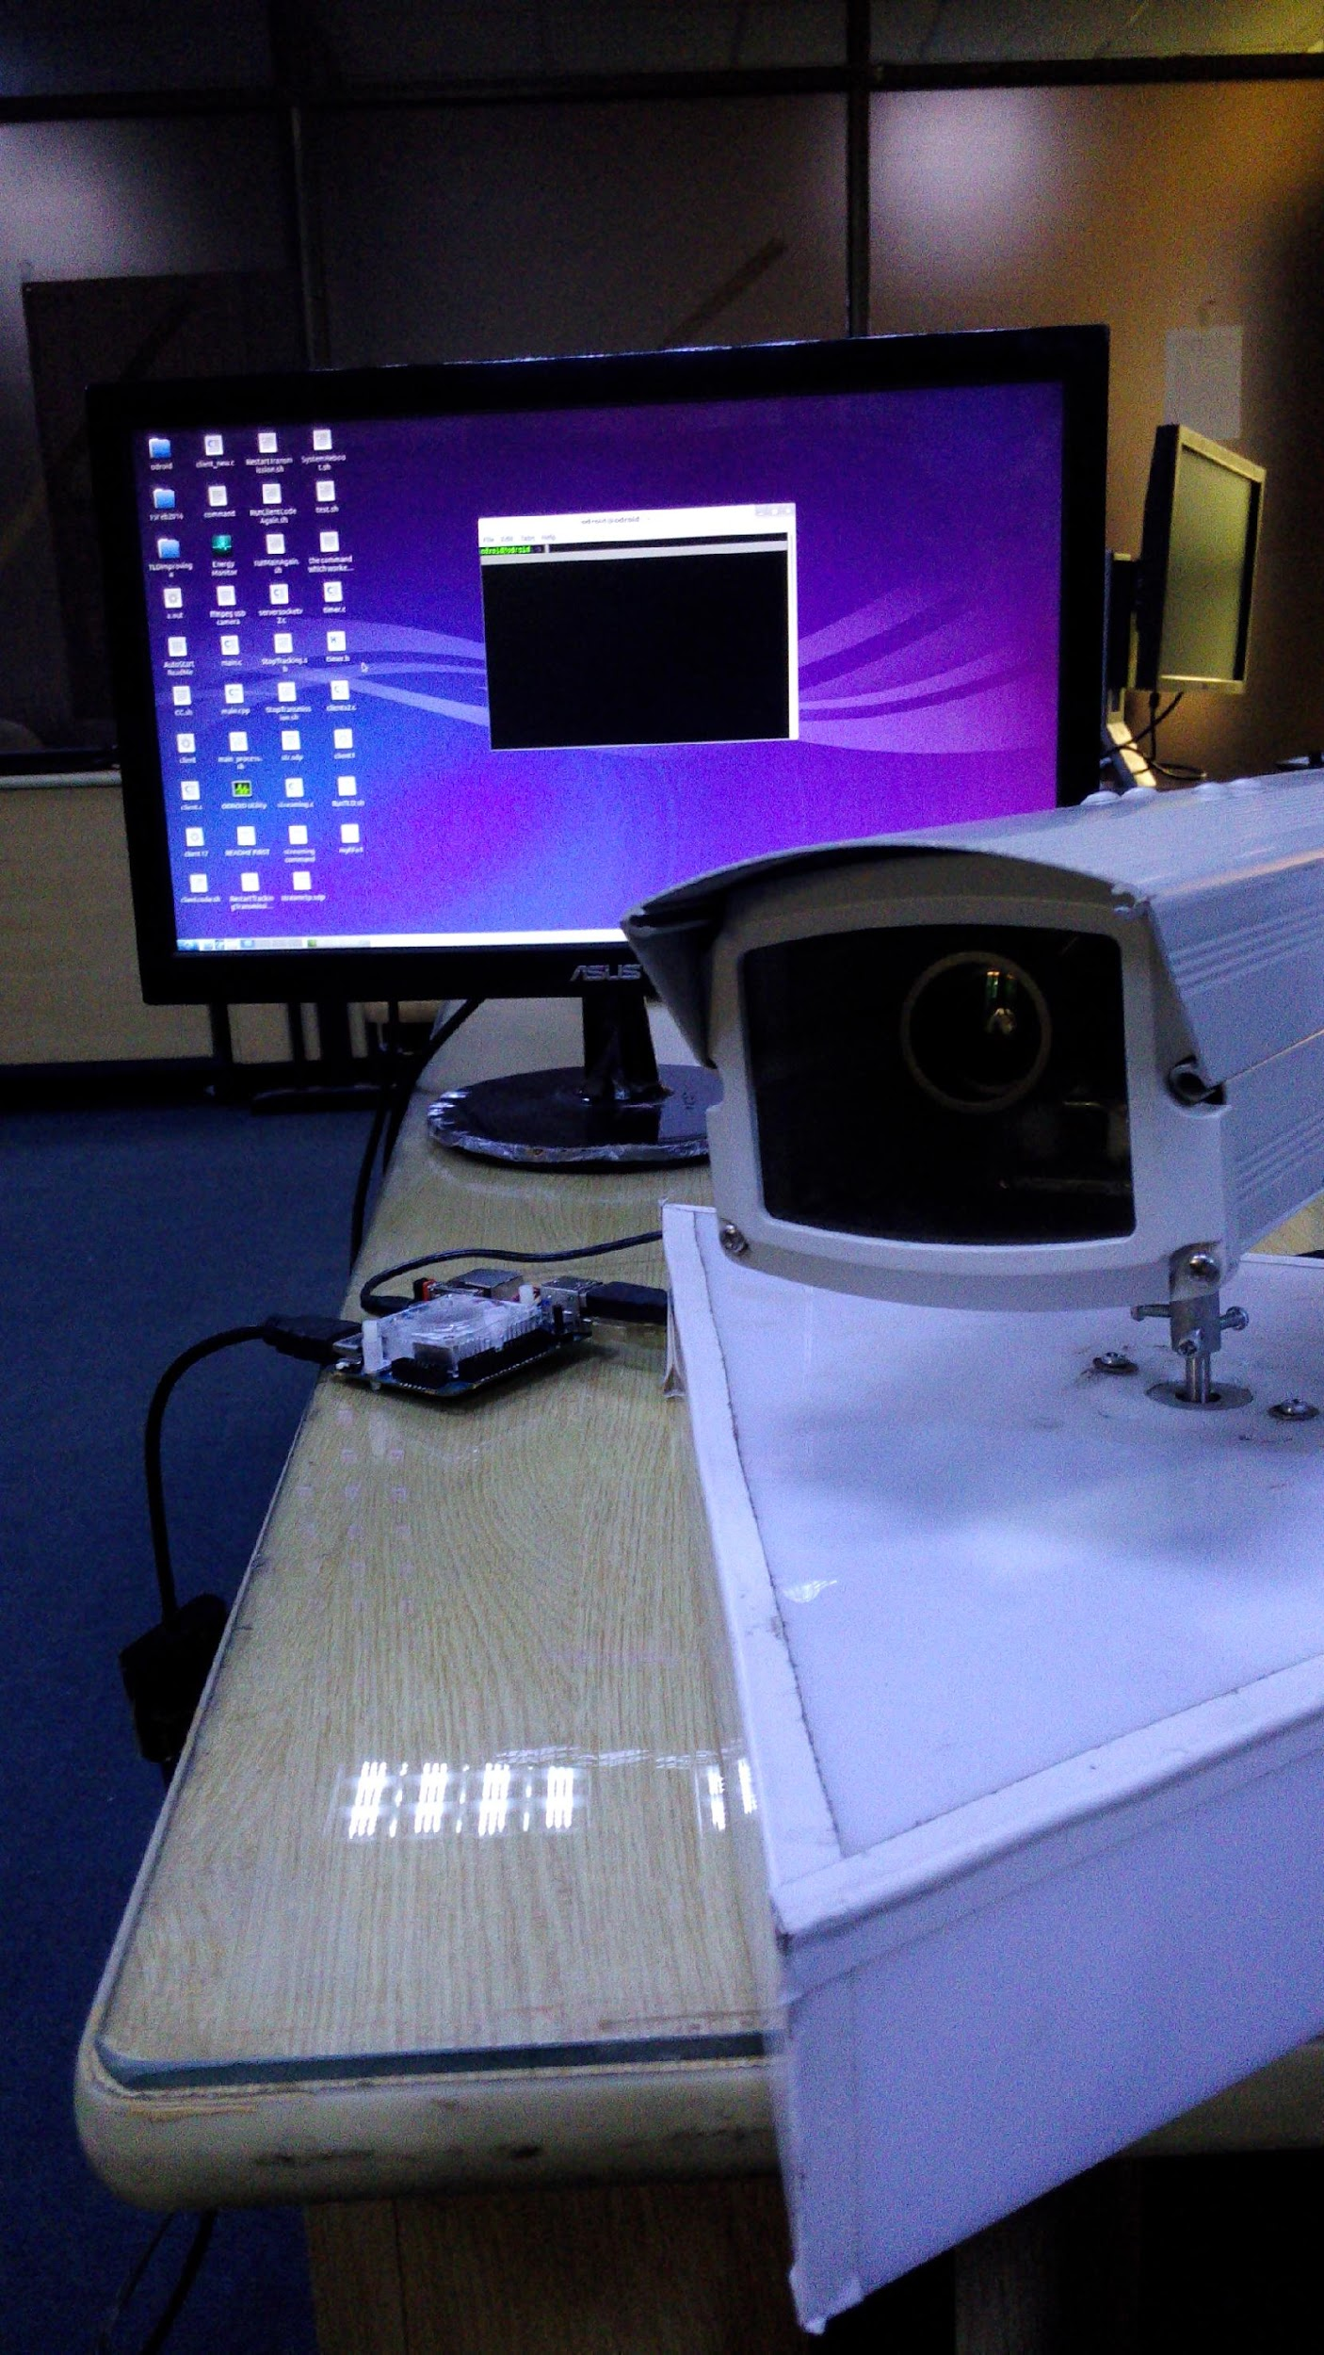

Slide 24
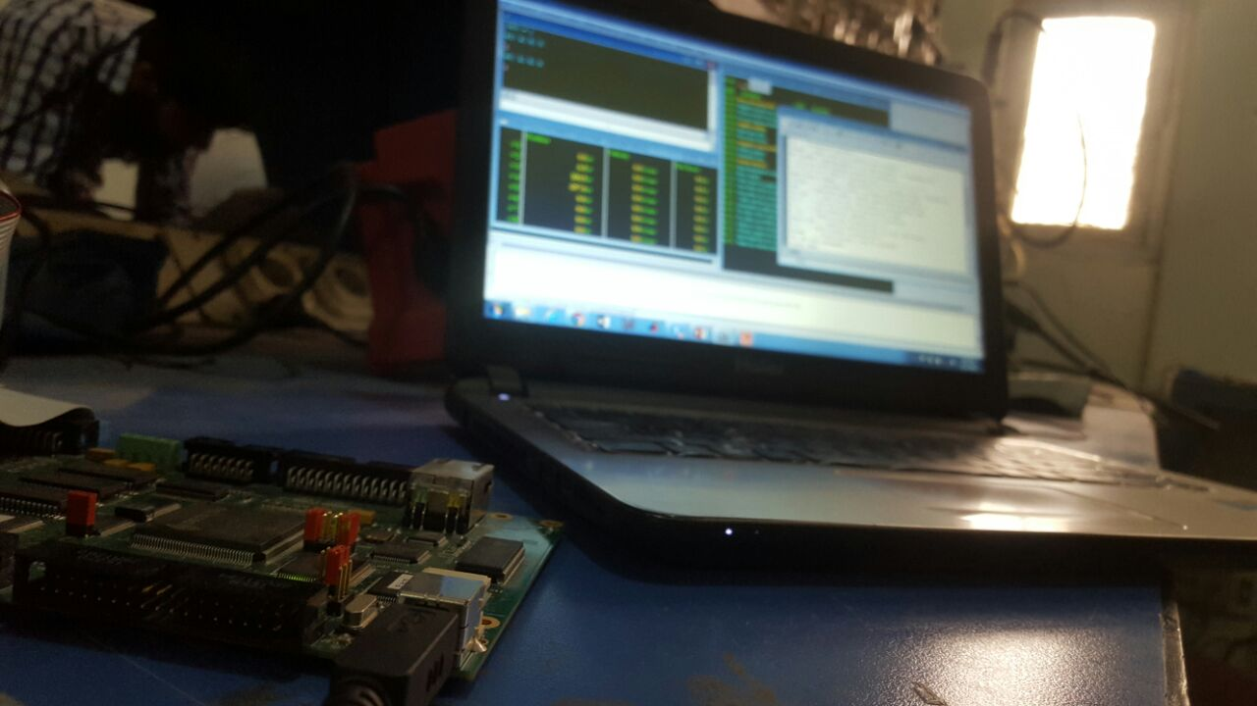
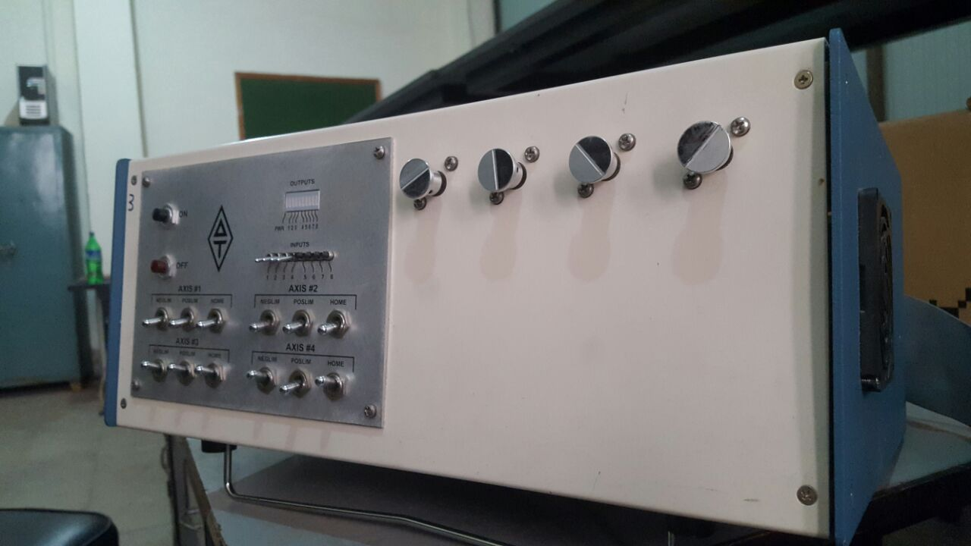

Slide 25
Future Deliverables
Improving the speed of Open TLD
Retrieving Co-ordinates of the Target
Co-ordinated motion of motors
Tuning gains to increase the tracking precision

Slide 26
Gantt Chart

Slide 27
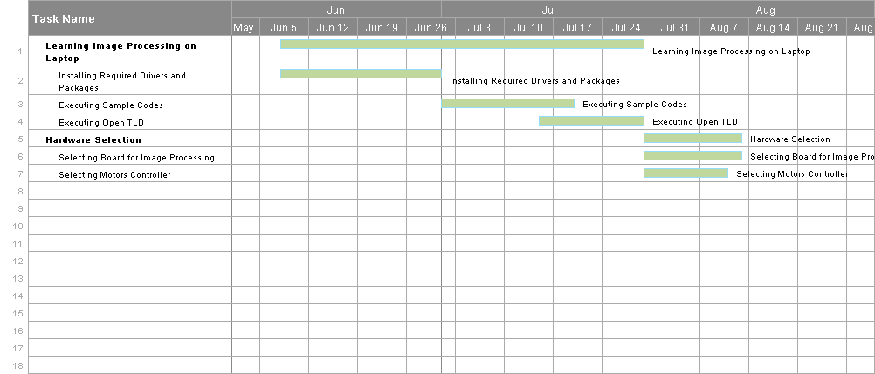

Slide 28
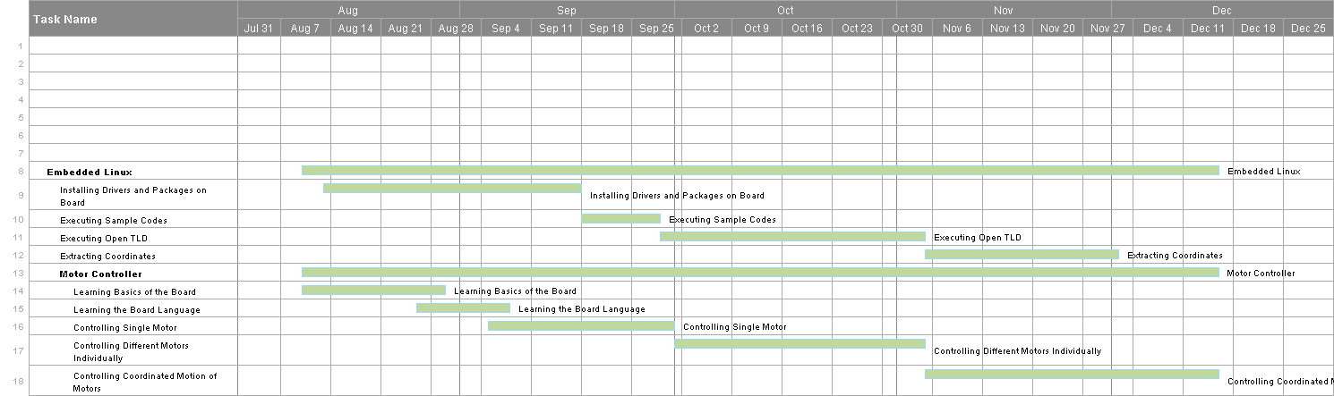

Slide 29
Reference
[1] www.projectsentrygun.rudolphlabs.com
Sentry Gun Picture 1:
https://www.pinterest.com/spyider/sentry-gun/
Sentry Gun Picture 2:
http://www.realsentrygun.com/Paintball%20Airsoft%20Turret%20Kit2.htm

Slide 30


Slide 31
Thank You

