Slide 1


Electromyography(EMG) based Robotic Arm
Group No: 29
Project Advisor: Dr. Ubaid Ullah Fayyaz
Department of Electrical Engineering,
University of Engineering and Technology, Lahore
Undergraduate Final Year Project Presentation
Dated: November 9, 2016

Slide 2
Team Introduction
Ali Yousuf (Team Leader)
2013-EE-039
Specialization: Electronics
Zohaib Salahuddin
2013-EE-012
Specialization: Electronics
Mamoon Masud
2013-EE-015
Specialization: Electronics
Maham Nasir Khan
2013-EE-006
Specialization: Computer
Undergraduate Final Year Project Presentation
Dated: November 9, 2016

Slide 3
Problem Statement
To propose a cost efficient and adaptive solution for amputees and paralyzed. To provide insight into Limb actuation of a normal person by EMG Signal Insertion.
Undergraduate Final Year Project Presentation
Dated: November 9, 2016

Slide 4
Proposed Solution
A bionic arm driven by acquiring EMG signals via myoware sensors will provide a robust solution for the amputees.
EMG signals processed will be inserted to provide insight into solution for the paralyzed.
Undergraduate Final Year Project Presentation
Dated: November 9, 2016

Slide 5
Block Diagram
Selection of EMG Electrodes
Signal Filtering and Signal Amplification
Digital Signal Processingand Machine Learning
Instrumentation amplifier and LPF and HPF circuits
3 servos to provide 6 DOFs
Undergraduate Final Year Project Presentation
Dated: November 9, 2016

Slide 6
EMG
What is EMG?
  “ EMG is the detection and recording of the electrical signal produced by muscle tissues as it contracts”
Undergraduate Final Year Project Presentation
Dated: November 9, 2016

Slide 7
Anatomy Overview & Electrode Placement
The muscles of the forearm can be divided into two:
  Anterior or Flexor Compartment
  Posterior or Extensor compartment
The Anterior muscles are further divided into three layers:
  Superficial
  Intermediate
  Deep

Slide 8
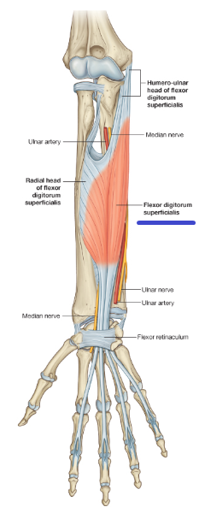
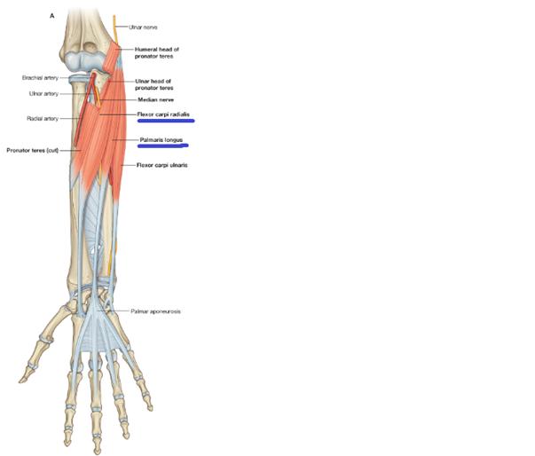
Anterior or Flexor Compartment
We are mainly interested in the superficial
and the intermediate layers.
In surface EMG their signal will be
maximum.
Their will be little or no signal from the
deep layers.
Superficial and Intermediate layers shown
in the figures.

Slide 9
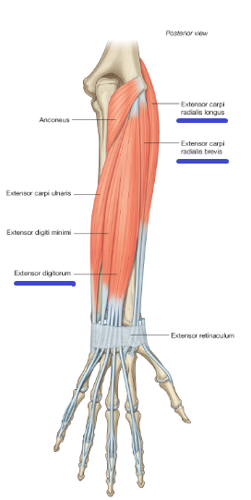
Posterior or Extensor compartment
The Posterior muscles are divided into
two layers:
  Superficial
  Deep
The Superficial layer is shown on the right
The third electrode is placed on the
‘Extensor Digitorum’ Muscle

Slide 10
Flow
Diagram
Undergraduate Final Year
Project Presentation
Dated: November 9, 2016

Slide 11
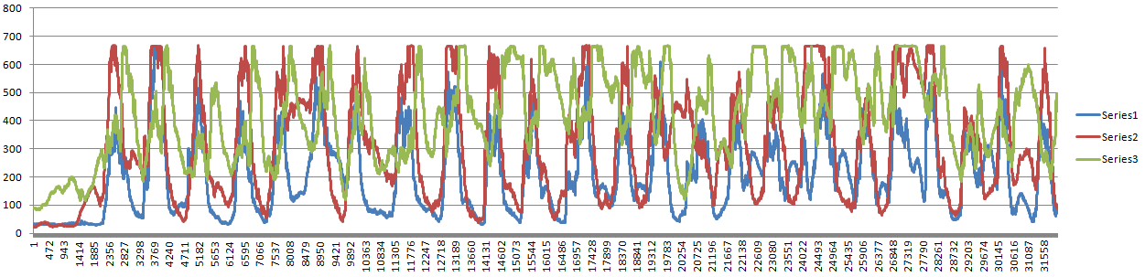
Distinct EMG Signals for Each Gesture
EMG SIGNALS FOR FIST FROM THREE SENSORS PLOTTED.
Undergraduate Final Year Project Presentation
Dated: November 9, 2016

Slide 12
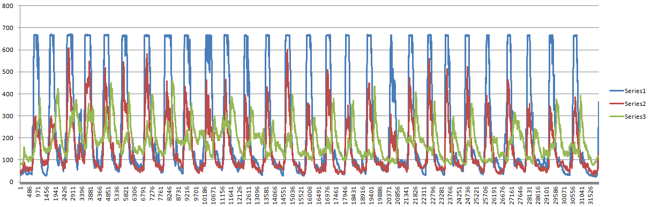
Distinct EMG Signals for Each Gesture
EMG SIGNALS FOR RING FINGER FROM THREE SENSORS PLOTTED.
Undergraduate Final Year Project Presentation
Dated: November 9, 2016

Slide 13
FEATURE EXTRACTION
After Extensive Review of literature, the following features were decided to be used for Classification:
Integrated EMG.
Mean Absolute Value.
Variance of EMG.
Slope Sign Change.
Zero Crossing.
Root mean Square.
Low frequency Response.
High Frequency Response.
Instantaneous Peak Values.
Undergraduate Final Year Project Presentation
Dated: November 9, 2016

Slide 14
MACHINE LEARNING
We aim at providing adaptive solution.
EMG SIGNALS vary with their
characteristic features from
one person to another.
Artificial Neural Network and Fuzzy Logic.
Undergraduate Final Year Project Presentation
Dated: November 9, 2016

Slide 15
COST EFFECTIVE SOLUTION
FOR EMG HAND
ITEM | COST ( in Rs.)
EMG SENSOR (x3) | 3000 x 3 = 9000
STM32F4 ( Smaller Demo Board) | 2000
Hand 4 DOF | 9000
TOTAL COST | 20000
Undergraduate Final Year Project Presentation
Dated: November 9, 2016

Slide 16
Signal Insertion for paralyzed
Paralyzed persons can’t control their limbs because nerve signals generated by the brain don’t reach limbs, either due to some illness or damage to spinal cord.
Limb muscles can be actuated by an external signal that is similar to the one generated by brain.
Signals generated by the brain can be wirelessly transferred to the limbs using spinal implants and TIENS pads.
Undergraduate Final Year Project Presentation
Dated: November 9, 2016

Slide 17
What we have done so far?:
Selection & importing EMG sensors.
Custom hand ordering.
Data acquisition from 3 sensors.
Extensive data dumping.
3 actions implemented with 90% success rate.
Undergraduate Final Year Project Presentation
Dated: November 9, 2016

Slide 18
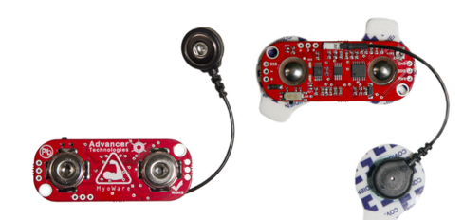
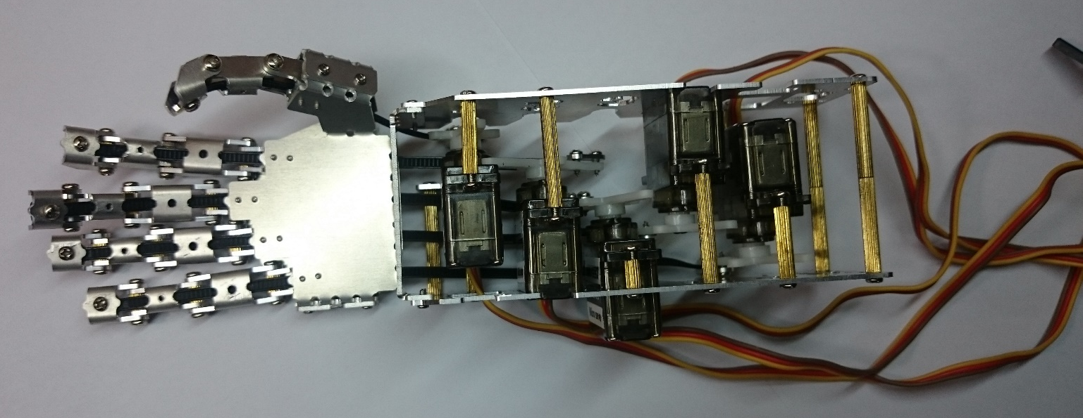
Hardware
MyoWare Muscle Sensor
Bionic Arm
Undergraduate Final Year Project Presentation
Dated: November 9, 2016

Slide 19
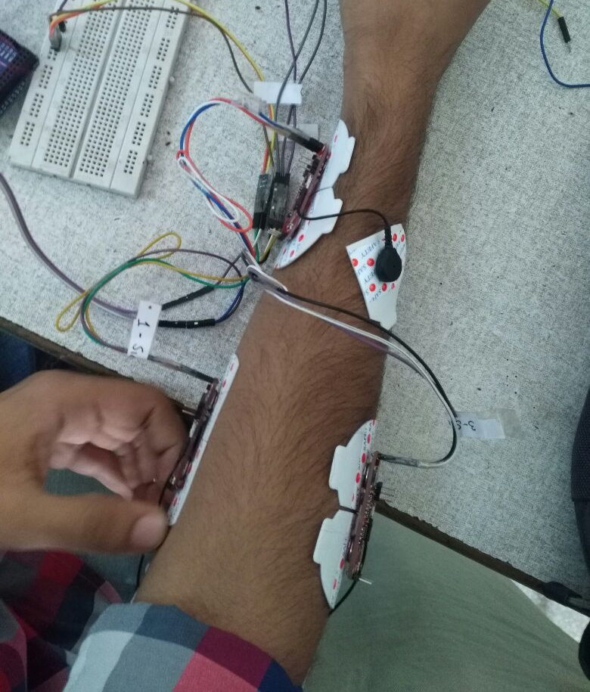
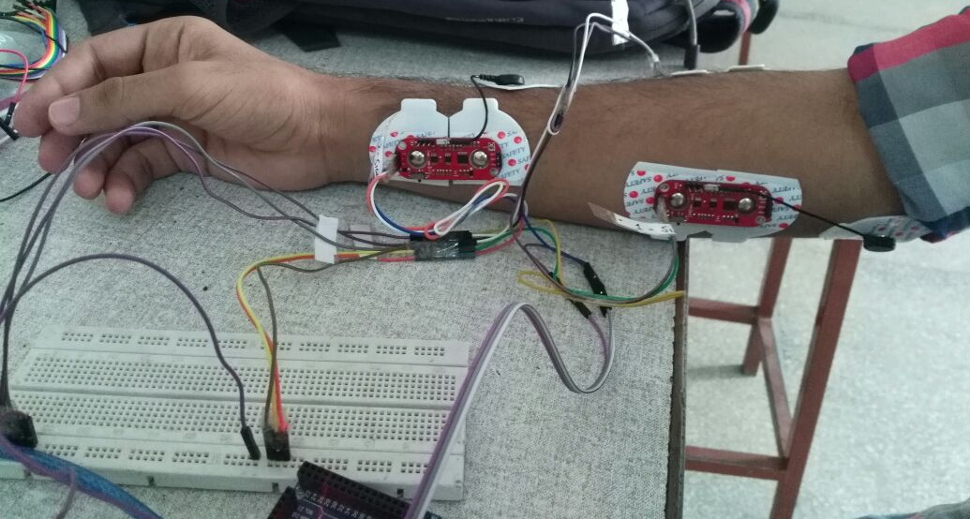
Hardware
Sensors connected to electrodes.
Undergraduate Final Year Project Presentation
Dated: November 9, 2016

Slide 20
Applications
Primary Applications
Amputees and those born without limbs will be able to get an affordable prosthetic limb.
Paralyzed persons will be able to use their limbs again.
Undergraduate Final Year Project Presentation
Dated: November 9, 2016

Slide 21
Applications
Secondary Applications
Gaming and Virtual Reality. No need of camera for gesture recognition.
Insertion of EMG signals can be used for physiotherapy of patients.
Undergraduate Final Year Project Presentation
Dated: November 9, 2016

Slide 22
Audience
Primary Audience
Amputees ( Military/ LEAs personnel, etc.)
Paralyzed
Healthcare professionals/Hospitals
Secondary Audience
Usage of gesture recognition for gaming and other purposes would open up a much larger market.
Undergraduate Final Year Project Presentation
Dated: November 9, 2016

Slide 23
Future Deliverables
Improving the gesture recognition algorithm.
Increasing the number of gestures to 10.
Machine learning for feature extraction
Adding wrist & elbow movements for a fully functioning robotic/bionic arm.
Insertion of EMG signal into hand for paralyzed person.
Wireless data transfer between sensors and hand.
Undergraduate Final Year Project Presentation
Dated: November 9, 2016

Slide 24
Gantt Chart
2016
06
07
08
09
10
11
12
2017
02
03
04
2017
Today
Studying Literature, selection of EMG
electrodes & custom hand ordering.
6/4/2016 - 7/31/2016
Ordering of one sensor and testing of the sensor.
7/27/2016 - 9/8/2016
Ordering of 2 more sensors & simultaneous data dumping.
Ordering of the custom robotic Arm.
9/9/2016 - 10/15/2016
Extensive data dumping & detection of 3 Gestures.
10/16/2016 - 11/4/2016
58 days
Feature Extraction & working on classifier
11/3/2016 - 12/24/2016
44 days
Implementing machine learning for gesture detection
1/2/2017 - 2/2/2017
37 days
20 days
Testing on Robotic Arm for 10 Gestures
2/3/2017 - 2/10/2017
52 days
32 days
Signal Insertion for paralyzed persons
2/27/2017 - 4/6/2017
8 days
39 days

Slide 25
REFERENCES
[1] Surface Electromyography Signal Processing and Classification Techniques Rubana H. Chowdhury 1,*, Mamun B. I. Reaz 1 , Mohd Alauddin Bin Mohd Ali 1 , Ashrif A. A. Bakar 1 , Kalaivani Chellappan 1 and Tae G. Chang 2
[2] De Luca, Carlo J., “A Practicum on the Use of Surface EMG Signals in Movement Science”.
DELSYS. May, 2008.
Undergraduate Final Year Project Presentation
Dated: November 9, 2016

